Slide 1

Literacy needs and opportunities in the Lincoln park community
By emily sherwood

Slide 2
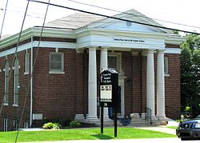
Description of Program
Lincoln Park United Methodist Church is a small congregation in the Lincoln Park Community of Knoxville, Tennessee.
While there are not many youth in the church and the church has very limited resources, the church desires to reach community youth with literacy.
Program designed to reduce achievement gap between lower and higher socioeconomic status children through book distribution.
  Research shows achievement gap can be greatly narrowed if poorer students have access to high-quality books about subjects that interest them (Allington et al, p.214).
  Volunteers collect books, then distribute to local schools, community centers, and daycares. Children choose books that they can then read at home.
  The church is also interested in expanding the program to meet other literacy needs of this community and Knoxville at large.

Slide 3
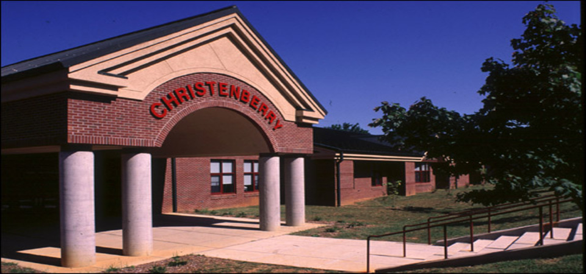
Stakeholders
Lincoln Park and community volunteers.
Thrift stores, book donors, business and church partners.
Social Service and education providers.
Students of local schools, as well as their parents and teachers.
Primary distribution sites=Christenberry Elementary and adjacent community center.
    76.6 % of students eligible for free and reduced lunch.
    Reading scores slightly lower than the state average=42% of students scored proficient on English/Language Arts test in 2014.
    Economically disadvantaged students scored 13.1% lower than higher socioeconomic students at the school in 2014 (Tennessee Department of Education, 2015, p.1).

Slide 4
Logic model
Inputs | Activities | Outputs | Outcomes
 |  |  | Initial | Intermediate | Long-term
The major investment is time: time gathering books, distributing books, reaching out to stakeholders, and planning collaboratively for book distributions. | We distribute books to children. | We reach children with books. | Children get to read a book they like. Families with limited books and literacy resources have materials. | Children become more motivated to read, and begin to read for pleasure more. Families begin to read together more. | The reading scores of participating children improve. Families grow closer as they read together. Children see reading as something they enjoy.

Slide 5
Purpose of evaluation
Two Main Purposes:
  Evaluate the literacy needs of the community to best serve residents in Lincoln Park and the surrounding areas.
  Evaluate the Book Distribution Process so that the process is as effective as possible and best utilizes the resources of the program and community.

Slide 6
Evaluation questions
What are the literacy needs of the Lincoln Park community?
How can books best be distributed to children?
What kinds of books do children desire to read?
What is the effect on book distribution on reading motivation and the reading habits of children in the community?
How can children be motivated to read more?
What resources are available for literacy in the Lincoln Park community that the church can assist and partner with?

Slide 7
Participants
Church and community volunteers=will participate in focus groups.
Social service and education providers=will participate in online surveys.
Parents and children at community center= will participate in 2 surveys about reading at home:
  One before book distribution.
  One 4-6 weeks after book distribution.
    Surveys and consent/assent forms will be translated into Spanish for Spanish-speaking children and parents, and survey and assent forms for children are developmentally-appropriate.
    Surveys and consent/assent forms will be read in English or Spanish to non-literate or low-literate parents and children.

Slide 8
Design/methodology
Recruitment will take place:
  Through existing contacts.
  With flyers at church, community center, and other places in the community.
  Qualtrics system will contact social service and education providers by email and invite them to take a short online survey.
Multiple data gathered, both quantitative and qualitative:
  Church and community volunteers=interviewed through focus groups.
  Parents and children=answer questions on surveys at community center.
  Social service and education providers=complete short survey on Qualtrics.
No tangible incentives for completing the surveys or attending the focus groups.

Slide 9
Procedures
Step 1= Book Distribution and Initial Surveys at Community Center.
  Students receive books, and the parents learn about the research.
  Parents/children complete the first survey this day.
Step 2= Focus Groups.
  Volunteers participate in focus groups at the church.
  Focus groups last about 1 hour and are digitally tape-recorded for transcription.
  2-3 focus groups anticipated, although the evaluator will hold as many as needed.
Step 3= Follow-Up Surveys Given at the Community Center
Step 4= Social Service and Education Provider Surveys.
  Sent electronically from Qualtrics.

Slide 10
Timeline
February 2017=Initial surveys given to parents and children at the community center.
February/March 2017= Focus groups held at the church.
March 2017 (4 weeks after initial surveys given at community center)=follow-up surveys given at the community center.
March/April 2017=Social service/education provider surveys given electronically.
April 2017= All data analyzed.
Late April/Early May 2017=report written/evaluation closed.

Slide 11
Survey measures
Student/Parent Surveys
  Demographics (age, first language, if student receives Special Education or ESL services).
  What kind of books the student likes to read.
  How much the student reads at home.
  Motivational factors=does the student like to read?
  Access to books the student likes to read.
  Follow-Up=same questions plus if student read the books.
Social Service/Education Provider Surveys:
  Services provided.
  Needs in the community.
Focus group guiding questions
  Needs of the community.
  Skills, interests and availability of volunteers.
  Access to literacy in the community.

Slide 12
Proposed analyses
Qualtrics= for social service and education provider survey data.
Microsoft Word=For focus group interview transcription.
Microsoft Excel=For data from student and parent surveys and key findings from focus groups.
Quantitative Data=Reported in Pie/Bar Chart Form.
Qualitative Data=Reported in Essay Form.

Slide 13
Qualifications of evaluator
Former teacher, with 9 years experience teaching English as a Second Language to students of all ages, language levels, and backgrounds.
Current Graduate Research Assistant at the University of Tennessee-Knoxville.
Extensive training in education, language, and reading methodology:
  Master’s of Arts in Teaching English as a Second Language-Carson-Newman University (2007).
  Educational Specialist Degree in Literacy Education-University of Tennessee-Knoxville (2012).
  Current Doctoral Student in Literacy Education-University of Tennessee-Knoxville.

Slide 14
Dissemination Plan
Results documented in both presentation and report format.
Presentation given to church and community volunteers and social service and education providers.
Report and/or presentation available for potential funders, partners, and other interested stakeholders.
Results will be published (with general ethical provisions such as pseudonyms for names) in presentation or journal form at major conference or in scholarly journal, as this is a subject with limited research but great interest among the scholarly community.

Slide 15
References
Allington, R., McGill-Franzen, A., Camilli, G., Williams, L., Graff, J., Zeig, J.,….Nowak, R. (2010). Addressing summer reading setback among economically disadvantaged elementary students. Reading Psychology, 31, 411-427.
Tennessee Department of Education. State report card. Retrieved 1 November, 2016, from https://www.tn.gov/education/topic/report-card.

