Slide 1




Undergraduate data science: Biological connections and assessing impacts
Louis J. Gross
National Institute for Mathematical and Biological Synthesis
National Institute for STEM Evaluation and Research
Departments of Ecology and Evolutionary Biology and Mathematics
University of Tennessee, Knoxville
Funded by NSF awards DUE-1544375 and DBI-1300426

Slide 2
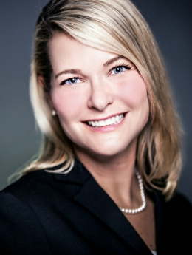
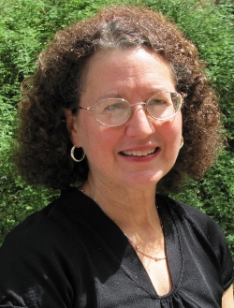

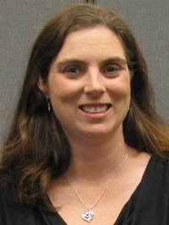
Project Personnel
    Pamela Bishop (PI) - Director of NISER, NIMBioS Associate Director for STEM Evaluation
    Suzanne Lenhart - NIMBioS Associate Director for Education and Outreach, Professor Mathematics
    Kelly Sturner - former NIMBioS Education and Outreach Coordinator
    Robin Taylor - NIMBioS Evaluation Postdoctoral Fellow

Slide 3
National Academies Committee on Envisioning the Data Science Discipline: The Undergraduate Perspective
http://sites.nationalacademies.org/CSTB/CurrentProjects/CSTB_175246
Look for a report soon

Slide 4
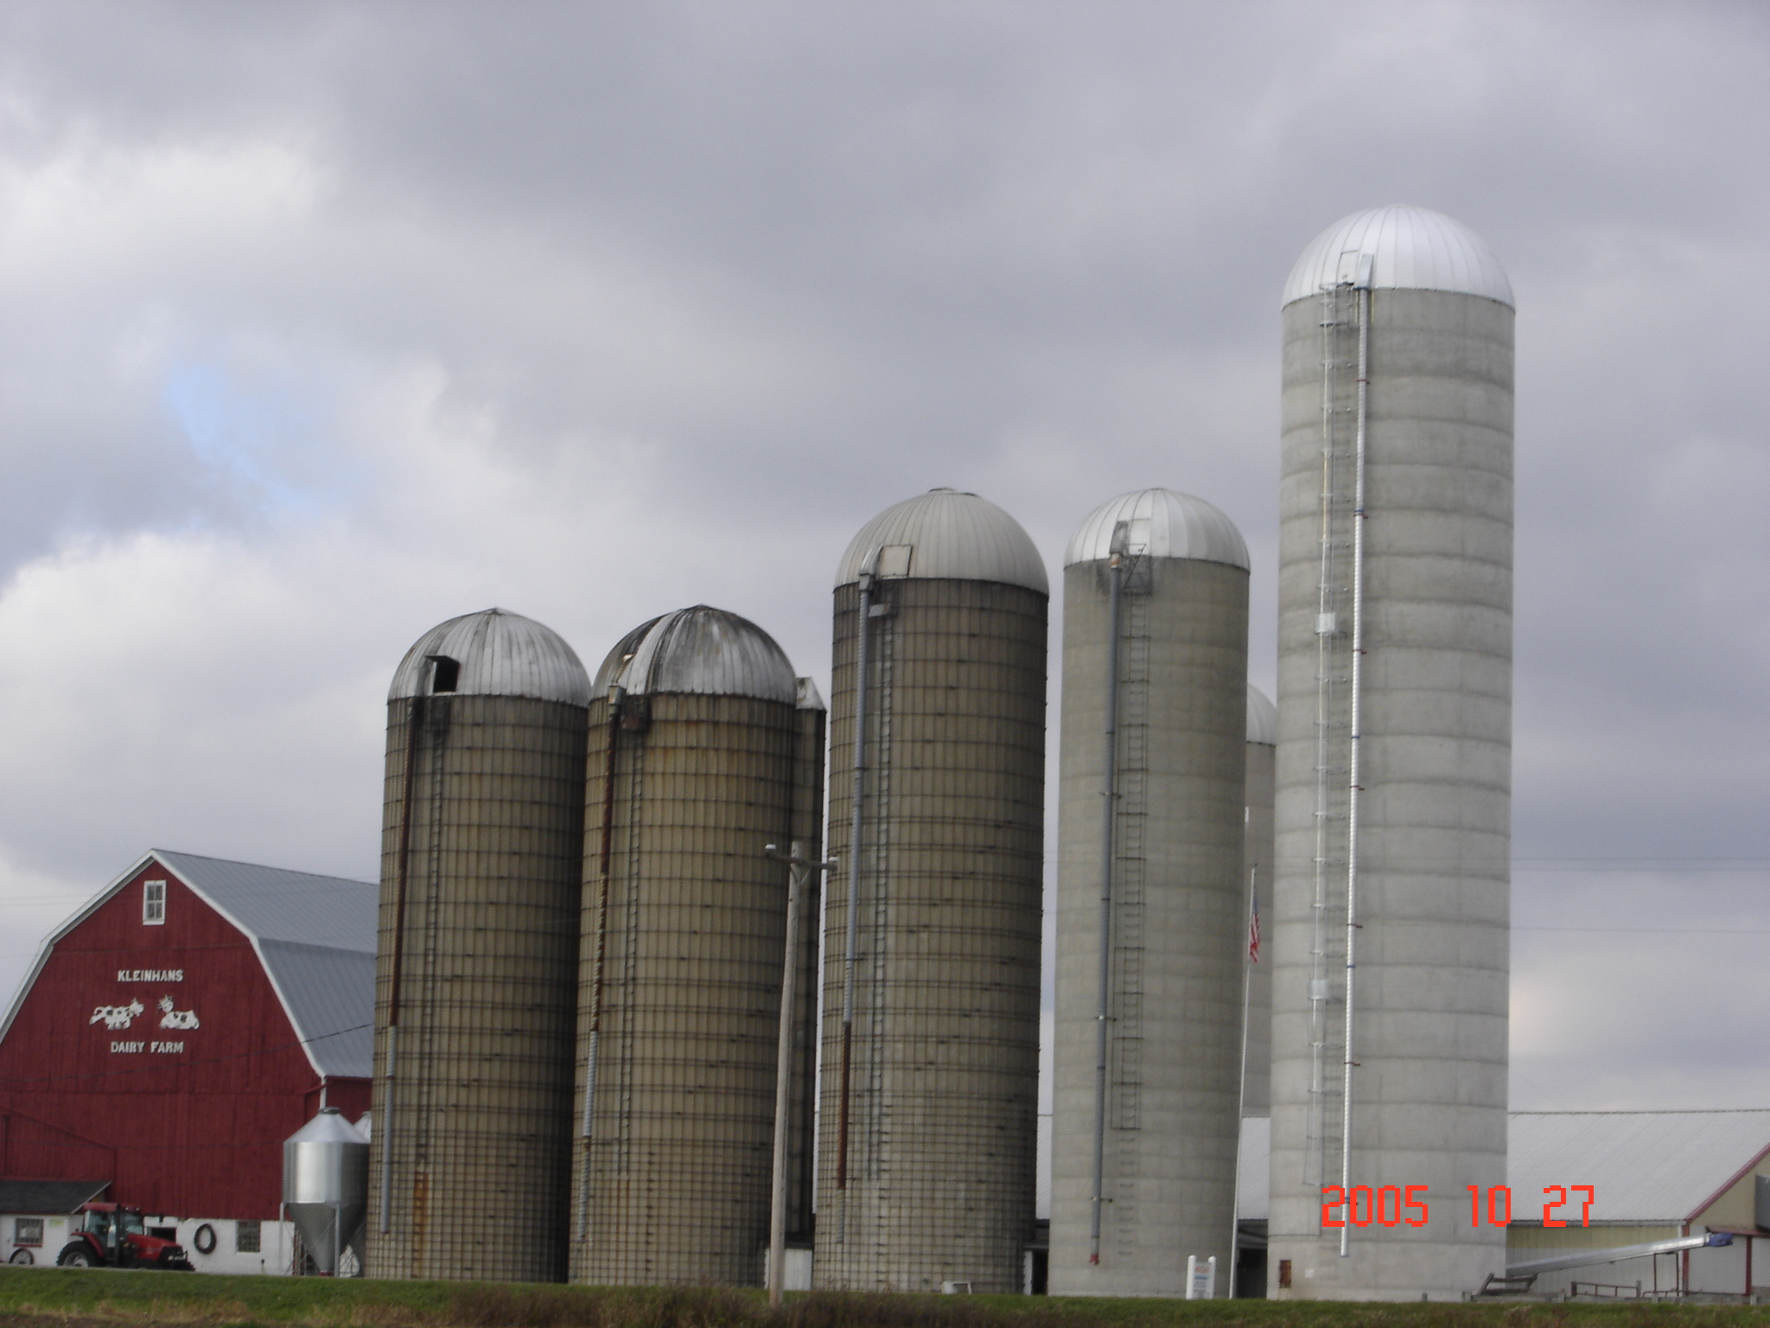

Biological Data Science
Information Science
Statistics
Computer Science
Biology
Mathematics
Notes:
There is not going to be one solution to this. Each institution will be finding its own way, with perhaps some general guidance. Some will want
a formal degree program,
one will want a minor,
some will want to have a data science thread built throughout the curriculum (like writing or quantitative general core requirements,
some accreditation agency will come into play eventually.
There are multiple routes to success in building data science into the undergrad curriculum. The home for these will be in various places dependent upon history, local politics and convenience.
IT IS UP TO THE LOCAL FACULTY

Slide 5
Dynamical systems
Optimization
Networks
Calculus
Graph theory
Linear algebra
Modeling
Stochastics

Slide 6
Inference
Distributions
Dynamical systems
Optimization
Networks
Calculus
Likelihood
Graph theory
Hypothesis testing
Modeling
Regression
Linear algebra
ANOVA
Bayes Methods
Stochastics

Slide 7
Inference
Distributions
Algorithms
Dynamical systems
Optimization
Cloud Computing
Networks
Calculus
Likelihood
Graph theory
Hypothesis testing
Hubs
Coding
Database Structure
Modeling
Regression
Linear algebra
ANOVA
Scripting
Bayes Methods
Stochastics

Slide 8
Inference
Curation
Distributions
Backup
Algorithms
Dynamical systems
Optimization
Cloud computing
Workflows
Networks
Calculus
Likelihood
Graph theory
Provenance
Hypothesis testing
Hubs
Data mining
Coding
Citation
Database Structure
Modeling
Regression
Linear algebra
Metadata
ANOVA
Scripting
Bayes Methods
Stochastics

Slide 9
Inference
Curation
Distributions
Backup
Algorithms
Dynamical systems
Optimization
Evolution
Workflows
Systems
Information flow
Cloud computing
Networks
Calculus
Likelihood
Graph theory
Provenance
Hypothesis testing
Citation
Hubs
Data mining
Coding
Energy transfer
Database Structure
Modeling
Regression
Linear algebra
Metadata
ANOVA
Scripting
Structure/Function
Bayes Methods
Stochastics

Slide 10
Inference
Curation
Distributions
Backup
Algorithms
Dynamical systems
Optimization
Evolution
Systems
Cloud computing
Networks
Workflows
Information flow
Calculus
Likelihood
Graph theory
Provenance
Hypothesis testing
Hubs
Data mining
Coding
Citation
Energy Transfer
Database Structure
Modeling
Regression
Linear algebra
Metadata
ANOVA
Scripting
Structure/Function
Bayes Methods
Stochastics
1
2
3
4
5
Course1

Slide 11
Curricular Organization as a Data-science Problem
Prioritization of concepts/skills
Use of education research to guide pedagogy
Borrowing/adapting existing materials (downscaling, not dumbing-down)
Sequencing coverage of concepts/skills
Enhancing high priority concepts/skills through repetition
Assessing success

Slide 12
Training Fearless Biologists: Quantitative Concepts for all our Students
1. Rate of change
2. Modeling
3. Equilibria and stability
4. Structure
5. Interactions
6. Data and measurement
7. Stochasticity
8. Visualizing
9. Algorithms
Slide presented at Bio2010 public release - Sept. 10, 2002 Listing arose from Workshops at UTK in 1992 and 1994. See Bio2010: Transforming Undergraduate Education for Future Research Biologists (NRC, 2003)

Slide 13



Mathematics for the Life Sciences – Princeton U. Press
Rule of Five- different learning styles to meet needs of diverse students: Symbolically, Graphically, Numerically, Verbally, Data-driven
We use this approach throughout the text which includes descriptive statistics (regression, semi-log, log-log), matrix algebra (eigenvalues, eigenvectors), discrete probability, discrete dynamical systems, basic calculus, differential equations, emphasizing data and hypothesis formulation (math and biological) using Matlab and R.
Erin Bodine
Suzanne Lenhart

Slide 14
What evidence is there that indeed introducing and/or motivating quantitative concepts through inclusion of data and models from the life sciences actually enhances learning of these concepts by our students?

Slide 15
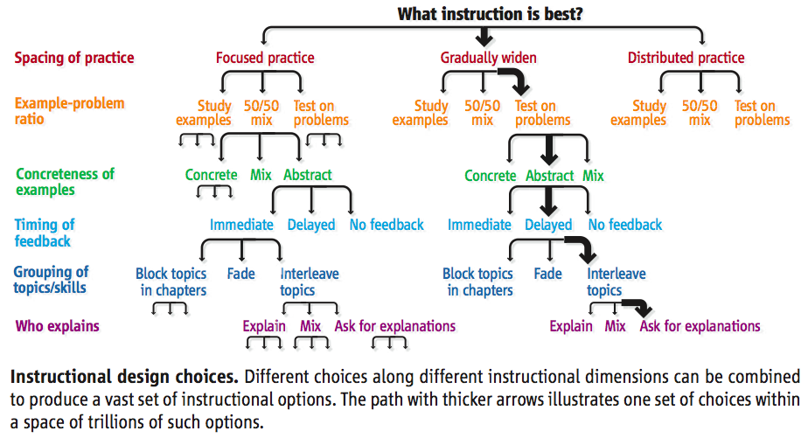
Koedinger, K. R., J. L. Booth, and D. Klahr1 Instructional Complexity and the Science to Constrain It. Science 342:935-7 (2013)

Slide 16
Evidence for the effectiveness of learning quantitative concepts through concrete examples and real data over abstract methods is mostly anecdotal. Very few studies investigate learning gains in mathematics arising from the use of scientific examples.
A first step towards evaluating the potential impact of biological examples on mathematics comprehension is to develop a robust assessment instrument designed for college-level math concepts.
Quantitative Biology Concept Inventory (QBCI)

Slide 17
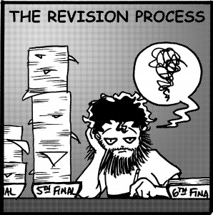
Quantitative Biology Concept Inventory Construction
Objectives/
Planning
Content Specification
Item Development
Test administration
Validity
Analysis

Slide 18


Objectives/Planning
Literature review of concept inventories

Slide 19

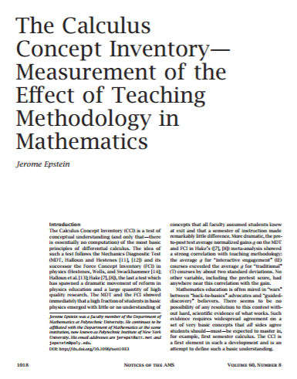
Content Specification
Calculus
  Rates of change
  Sums and Integration
  Modeling
  Interpreting Graphs and Data

Slide 20
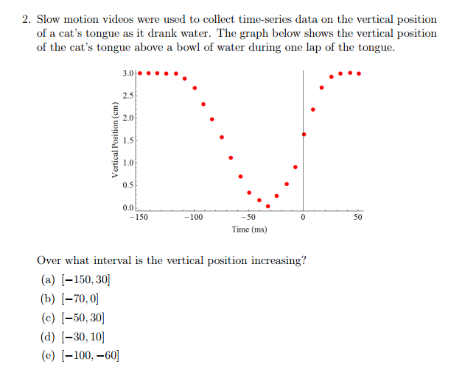

Item Development (Example 1)

Slide 21
Test Review and Administration
Expert review
Student focus group completion
Fall 2016 Administration
  Calculus I, Calculus II, Math for Life Sciences
  Pre-post testing
Spring 2017 administration (n ~ 200)
  Calculus I, Calculus II, Math for Life Sciences
  Pre-post testing
REVISE
REVISE

Slide 22
Validity Analysis
Item Response Theory (IRT): family of latent trait models used to establish psychometric properties of items and scales
Rasch Modeling: Demonstrate relationship between item difficulty and person ability
  Probabilistic unidimensional model
    Easier test question, higher likelihood of a correct response
    More capable the student, higher likelihood of getting questions correct versus less capable (or able) student
  Assumes probability a student correctly answers a question is a logistic function of the difference between the student’s ability and the difficulty of a question
PROVIDES A LOT OF INFORMATION ABOUT TEST QUESTIONS TO HELP EXAMINE THE QUALITY OF TEST CONSTRUCTION

Slide 23
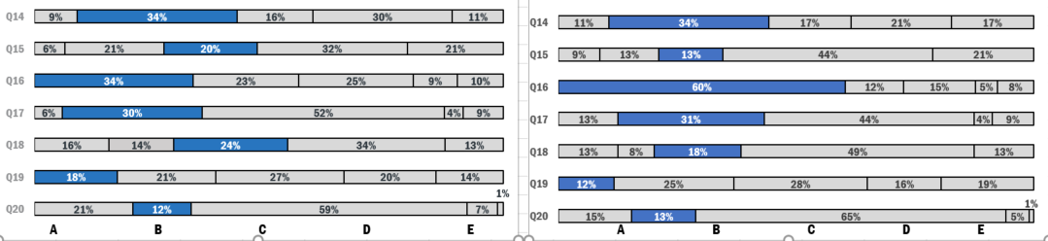
Example distribution of QBCI responses
Correct responses are in blue
Pre-administration of the QBCI
Post-administration of the QBCI
Notes:
Used to explore the frequency distribution of responses selected by participants. This is used to see if any distractors (i.e., response options) for the test are not being considered by students as plausible. If a distractor is not distracting (i.e., not being selected), you may want to consider revising or removing.
Could also be used to explore what misconceptions students may have regarding the material – i.e., why is option C for Q17 and Q20 being selected by so many students.

Slide 24
Item discrimination by item difficulty for QBCI
Notes:
Item difficulty is calculated as the mean percentage of correct answers for a given test item, and values range from 0.00 to 1.00, where 0 indicates no one got the item correct and 1 indicates everyone got the item correct.
Item discrimination refers to how well an item differentiates (distinguishes) between high and low test performers. Scores can range from -1 to +1, with scores closer to 1 showing stronger differentiation between the groups. Negative values indicate lower performers did better on average than high performers.
For the QBCI, item discrimination was computed by taking the mean score differences for high performers and low performers, where low performers are the lowest 25% of the sample, and high performers are typically the highest 25% of the sample.
The trend lines are used to demonstrate the following rules of thumb: Item difficulty – too easy (greater than .80) and items that are too hard (less than .20). Item discrimination of at least .20. Want to pinpoint items that don’t discriminate well and/or are too hard/easy. Maybe Q19 for the spring administration….would want to review item to see if it should be revised or removed from a test.

Slide 25
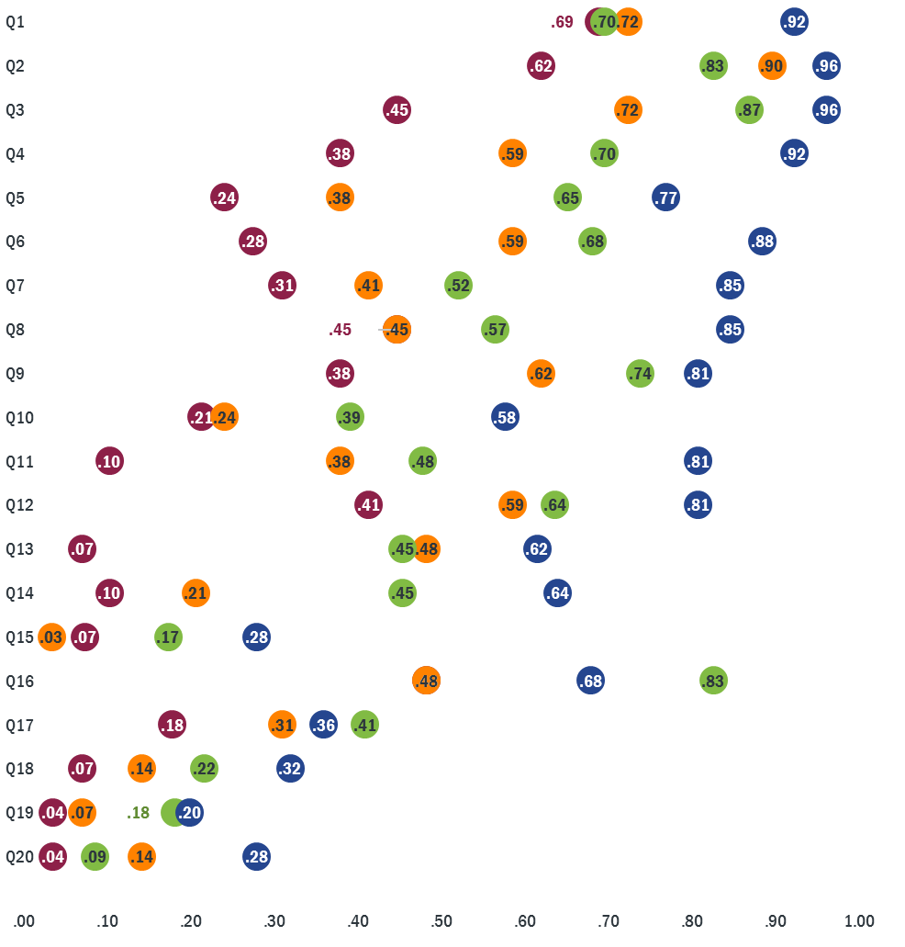
Item difficulty by groups of overall test performance
Low performers
(<=7 correct)
Mid-Low Performers
(8 or 9 correct)
Mid-High performers (10 and 11 correct)
High performers
(>= 12 correct).
Item difficulty
Notes:
Comparing the item difficulty, mean average of correct responses according to students overall performance category. Categories were created based on quartiles of those in the highest 25%, median to 75%, 25% to median, and lowest 25% of overall total correct test responses. How the quartiles were divided for spring 2017 are included within the legend on the left.
This is just an additional way to compare the discrimination, but now looking at the middle groups also.

Slide 26
There is some, but not much, evidence that quantitative education of life science students can be enhanced by incorporating biological examples and data in quantitative courses. Many (likely fundable) projects on this remain to be done by education researchers.
There is some, but not much, evidence that quantitative education of life science students can be enhanced by incorporating quantitative ideas in biology courses. Many (likely fundable) projects on this remain to be done by education researchers.
STEMeval.org

Slide 27
References and Further Reading
Quantitative Biology
  National Research Council, BIO2010: Transforming Undergraduate Education for Future Research Biologists. 2003, Washington, DC: The National Academies Press.
  Brewer, C.A. and D. Smith, Vision and change in undergraduate biology education: a call to action. American Association for the Advancement of Science, Washington, DC, 2011.
  Bodine, E.N., S. Lenhart, and L.J. Gross, Mathematics for the Life Sciences. 2014: Princeton University Press.
Concept Inventories
  Epstein, J. (2006). The calculus concept inventory. National STEM Assessment, Washington, DC, 60-67.
  Jarrett, L., Ferry, B., & Takacs, G. (2012). Development and validation of a concept inventory for introductory-level climate change science.
Test development
  Downing, S. M., & Haladyna, T. M. (2006). Handbook of test development. Lawrence Erlbaum Associates Publishers.
Rasch analysis
  Boone, W. J., Staver, J. R. & Yale, M. S. (2014). Rasch analysis in the human sciences. Springer, Dordrecht, Netherlands.
  TEAMS Project Webinars: Diagnosing Your Survey Using Rasch Modeling (Level 1/2): Karen Drill and Erin Stack: http://teams.mspnet.org/
www.stemeval.org

