Slide 1




Developing the Quantitative Biology Concepts Inventory (QBCI)

Slide 2

Research Team
NSF EAGER award
Pamela Bishop (PI)
Director of NISER, NIMBioS Associate Director for STEM Evaluation
Louis Gross (Co-PI)
Professor Ecology & Evolutionary Biology, Director TIEM, Director Emeritus NIMBioS
Suzanne Lenhart (Co-PI)
NIMBioS Associate Director for Education and Outreach, Professor Mathematics
Kelly Sturner(Co-PI)
NIMBioS Education and Outreach Coordinator
Robin Taylor
Postdoctoral Fellow

Slide 3
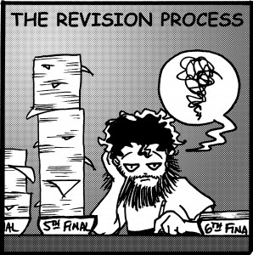
QBCI Construction
Objectives/
Planning
Content specification
Item development
Test administration
Validity analysis

Slide 4
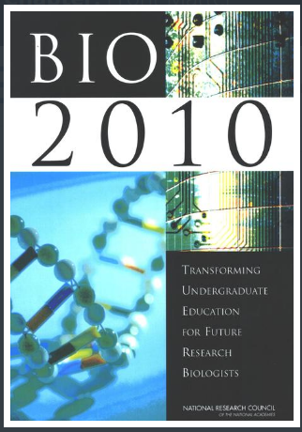
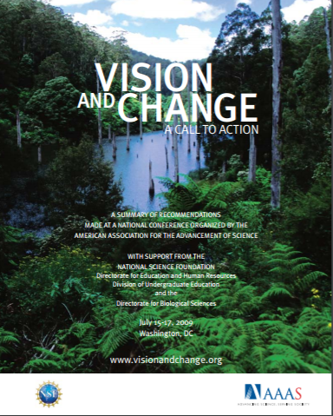
Objectives/Planning
Literature review of concept inventories

Slide 5

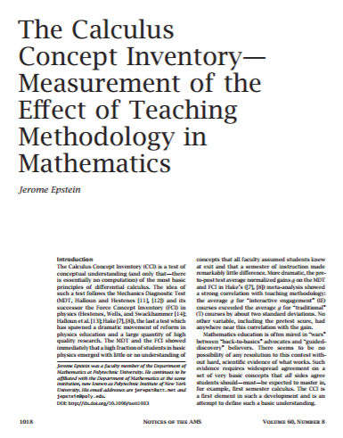
Content Specification
Calculus
Rates of change
ADD HERE

Slide 6
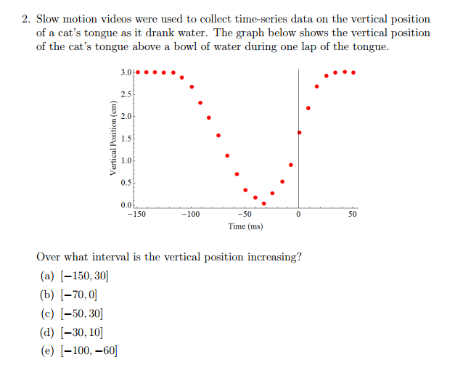
Item Development (ex. 1)

Slide 7
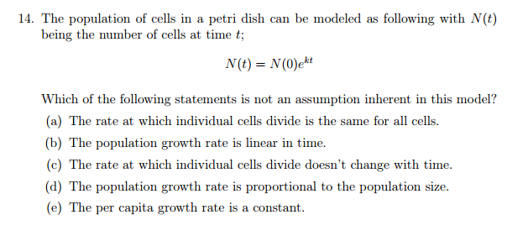
Item Development (ex. 2)

Slide 8
Test Administration
[Expert review]
Focus group completion (n = )
Fall 2016 Administration (n = )
Calculus I, Calculus II, Math for Life Sciences
Pre-post testing
Spring 2017 administration (n ~ 200)
Calculus I, Calculus II, Math for Life Sciences
Pre-post testing
REVISE
REVISE ?

Slide 9
Validity Analysis
Item Response Theory (IRT): family of latent trait models used to establish psychometric properties of items and scales
Rasch Modeling: Demonstrate relationship between item difficulty and person ability
Probabilistic unidimensional model
Easier test question, higher likelihood of a correct response
More capable the student, higher likelihood of getting questions correct versus less capable (or able) student
Assumes probability a student correctly answers a question is a logistic function of the difference between the student’s ability and the difficulty of a question
PROVIDES A LOT OF INFORMATION ABOUT TEST QUESTIONS TO HELP EXAMINE THE QUALITY OF TEST CONSTRUCTION

Slide 10
References and Further Reading
Quantitative Biology
National Research Council, BIO2010: Transforming Undergraduate Education for Future Research Biologists. 2003, Washington, DC: The National Academies Press.
Brewer, C.A. and D. Smith, Vision and change in undergraduate biology education: a call to action. American Association for the Advancement of Science, Washington, DC, 2011.
Bodine, E.N., S. Lenhart, and L.J. Gross, Mathematics for the Life Sciences. 2014: Princeton University Press.
Concept Inventories
Epstein, J. (2006). The calculus concept inventory. National STEM Assessment, Washington, DC, 60-67.
Jarrett, L., Ferry, B., & Takacs, G. (2012). Development and validation of a concept inventory for introductory-level climate change science.
Test development
Downing, S. M., & Haladyna, T. M. (2006). Handbook of test development. Lawrence Erlbaum Associates Publishers.
Rasch analysis
Boone, W. J., Staver, J. R. & Yale, M. S. (2014). Rasch analysis in the human sciences. Springer, Dordrecht, Netherlands.
TEAMS Project Webinars: Diagnosing Your Survey Using Rasch Modeling (Level 1/2): Karen Drill and Erin Stack: http://teams.mspnet.org/

