Slide 1
EEB 504 and EEB 607 - Spring 2021 - Careers in Academia: How to Enhance your Chances for Success
Instructor: Louis J. Gross
Chancellor’s Professor, Departments of Ecology and Evolutionary Biology and Mathematics
Structure of Higher Education Institutions, Processes, Departmental Structures
Feb 15, 2021

Slide 2
Outline of course topics:
Types of higher education institutions;
How colleges and universities work;
Where the money comes from and where it goes;
Various roles of a faculty member and prioritizing among them;
Stages of a career;
Planning for transitions in career stages;
Position searches and how to apply;
Mentoring - getting it and giving it;
Enhancing your teaching;
Building your communication capabilities;
Administrators and how they impact your career;
Effectively preparing for evaluations at various levels;
Funding your scholarship;
Participating in the broader academic community in your field;
Building effective collaborations;
Combining your personal life and academic expectations;
Time management.

Slide 3
Processes at Higher Educational Institutions:
These vary somewhat between institutions and there are typically formal documents providing guidance:
Governance (roles of Board, administration, faculty, staff – shared governance)
Academic program policies (faculty, administration)
Hiring, compensation and retention policies (Faculty handbook, staff handbook, HR policies)
Student affairs – admissions, activities, athletics (administration, staff)
Facilities and finances (administration)
Research and scholarship (administration, compliance legal staff)
Development/fundraising (administration, staff)
Diversity/inclusion (administration, faculty, staff)
External relations, media, government (administration)

Slide 4
Basic Structure of a University System
Board of Trustees
President/Chancellor
Vice Presidents
Campus Chancellors
Offices for Research, Academics, Development, Treasurer, Government Relations
Campus Administration

Slide 5
Basic Structure of a Campus
Chancellor
Provost
Vice Chancellors for Student Affairs, Development, Communications, Finance, Research, Diversity
Athletics
Deans
Department Heads
Associate Deans
Faculty

Slide 6
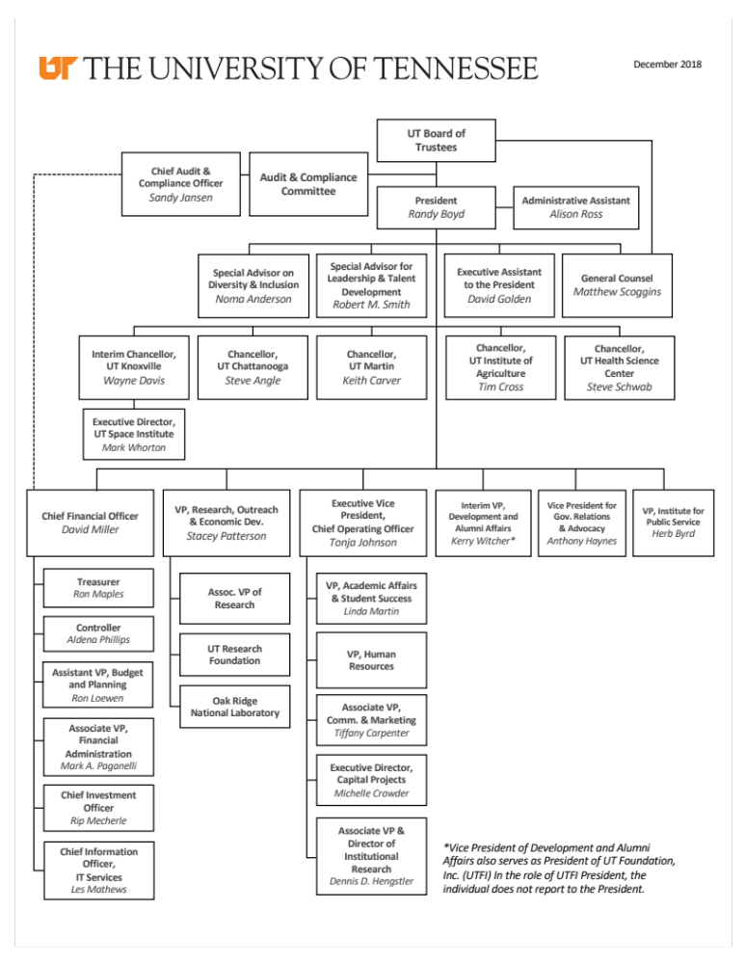
From UT President Website

Slide 7
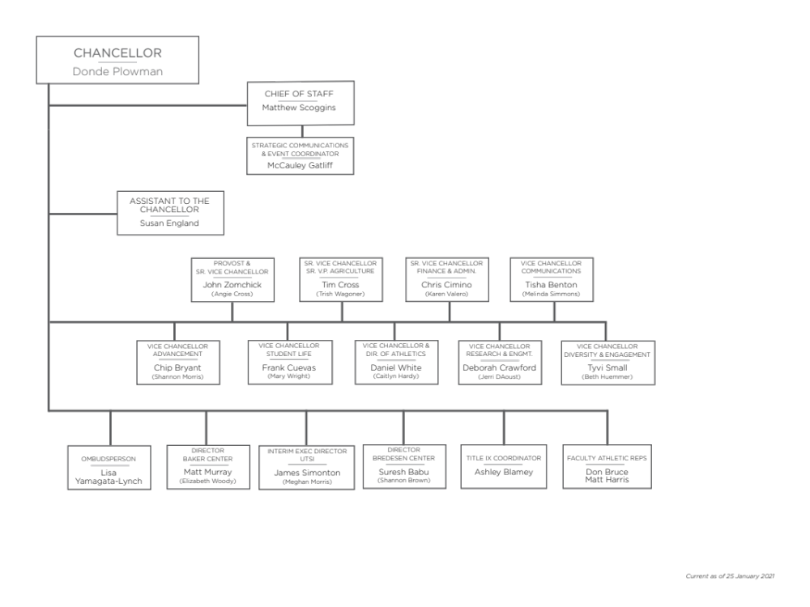
UTK Organization chart

Slide 8
Departmental Structures:
Except for those reporting to some type of center or interdisciplinary units, faculty generally report to a Department.
There are two general ways Departments are led:
Department Head – appointed by a Dean, serves at the pleasure of the Dean for 3-5 years and often longer, has authority over issues such as recommending raises for faculty, and decisions on hiring by making recommendations to Dean – may be external hire
Department Chair – elected by the faculty though appointed formally by Dean, serves at the pleasure of the faculty, expected to rotate among senior faculty who take their turn serving typically a 3-year term, may not have authority over faculty salary, hiring decisions typically made by faculty and then recommended by Chair to Dean – usually internal appointment

Slide 9
Departmental Structures:
Governance documents –
Bylaws of the Department typically provide guidance on hiring practices; expectations for retention, promotion and tenure that are specific to the department to expand on those provided in a Faculty Handbook; committees such as graduate affairs and undergraduate affairs; appointment, responsibilities and evaluation of Head/Chair; expectations regarding mentoring of undergraduate and graduate students. You can see examples of UTK Bylaws at https://senate.utk.edu/bylaws/
Curricular plans – as approved by the faculty for all degrees and aligned with College/University requirements
Student handbooks – typically only for Graduate students with undergrads referred to curricular materials

