Slide 1
Math/EEB 589 - Mathematics of Machine Learning Methods in Ecology and Environmental Science
Overview of the Classification Problem
Classification – the process by which objects (data elements) are placed into groups. The object is to place similar objects into identifiable and interpretable classes that can be differentiated from neighboring classes. Taxonomy is an example – assigning a collection of specimens to species, genera, families, etc. The objective is the same no matter whether the characteristics of the specimens used are genetic traits, genetic sequences, morphology, etc.
This process is distinct from ordination – separating observations or samples along gradients of some environmental variable (e.g. elevation, moisture, temperature, latitude, etc.) which is typically continuous. Ordination identifies patterns within gradients while classification focuses on the endpoints or extremes of the gradients in ecology.

Slide 2


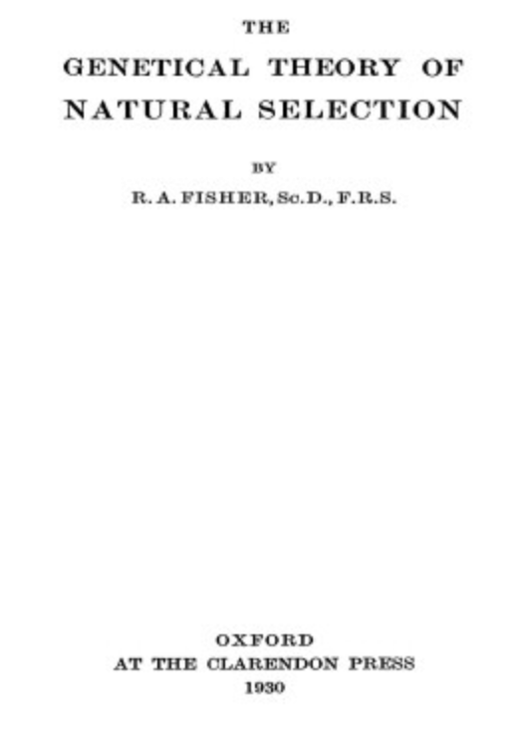

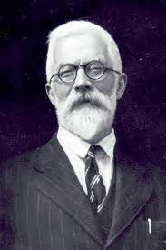
Iris versicolor
Iris setosa
Iris virginica

Slide 3
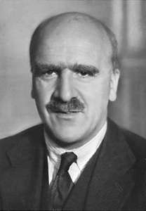
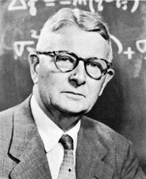
R. A. Fisher
J. B. S. Haldane
Sewell Wright
These three are considered the founders of The Modern Synthesis ⁻ the early 20th-century synthesis reconciling Darwin’s theory of evolution and Mendel's ideas on heredity in a joint mathematical framework

Slide 4
RA Fisher, statistician and geneticist extraordinary: a personal view
Walter Bodmer
International Journal of Epidemiology, Volume 32, Issue 6, December 2003, Pages 938–942, https://doi.org/10.1093/ije/dyg289
His first substantial, and indeed seminal paper on genetics was that on The Correlation Between Relatives on the Supposition of Mendelian Inheritance. (1918) The paper opens with the sentence, ‘Several attempts have already been made to interpret the well-established results of biometry in accordance with the Mendelian scheme of inheritance’. That is indeed what this paper achieved. On the first page just a few sentences further down he says:
“It is therefore desirable in analysing the causes of variability to deal with the square of the standard deviation as the measure of variability. We shall term this quality the Variance of the normal population to which it refers, and we may now ascribe to the constituent causes fractions or percentages of the total variance which they together produce.”
Here in one sentence was the introduction of the word variance as it is now commonly used in statistics, and of the notion of the analysis of variance. This paper has an interesting history. It was first submitted for publication to the Royal Society of London some 2 years earlier, but rejected. It was eventually published by the Royal Society of Edinburgh through the intervention of Leonard Darwin, Charles Darwin’s youngest son and a strong influence and mentor of Fisher’s, who paid £50 towards the cost of the paper’s publication. Fisher later learnt that the referees were Karl Pearson, then Galton Professor of Eugenics at University College, and RC Punnett, the Arthur Balfour Professor of Genetics in Cambridge. He delighted to recount, as I heard him say myself, that these two rejected his paper, ‘both of whom I later succeeded’.

Slide 5
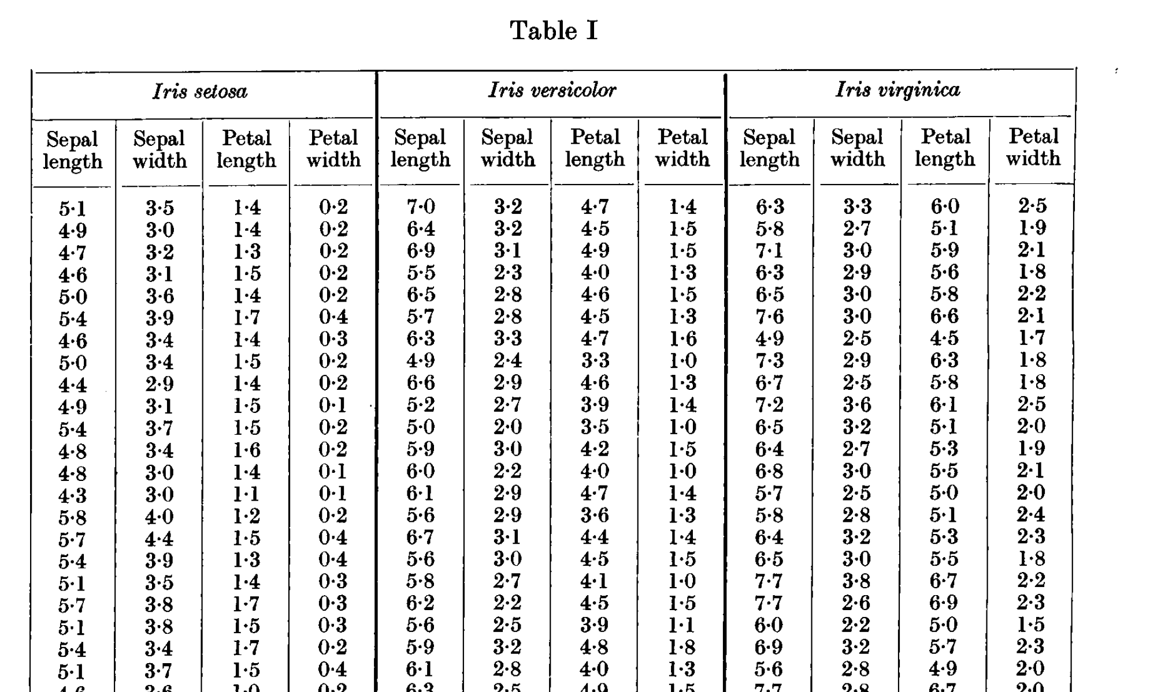
Fisher, R. A. 1936. The use of multiple measurements in taxonomic problems. Annals of Eugenics 7:179-188

Slide 6
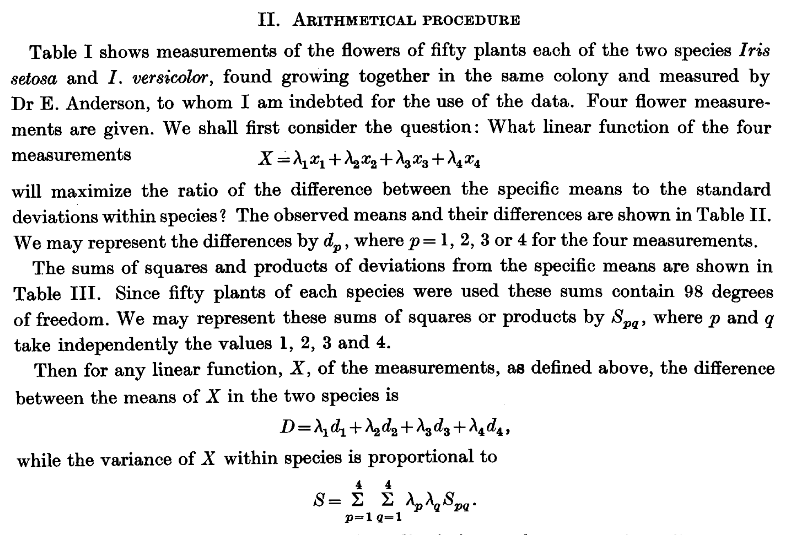
Fisher, R. A. 1936. The use of multiple measurements in taxonomic problems. Annals of Eugenics 7:179-188

Slide 7
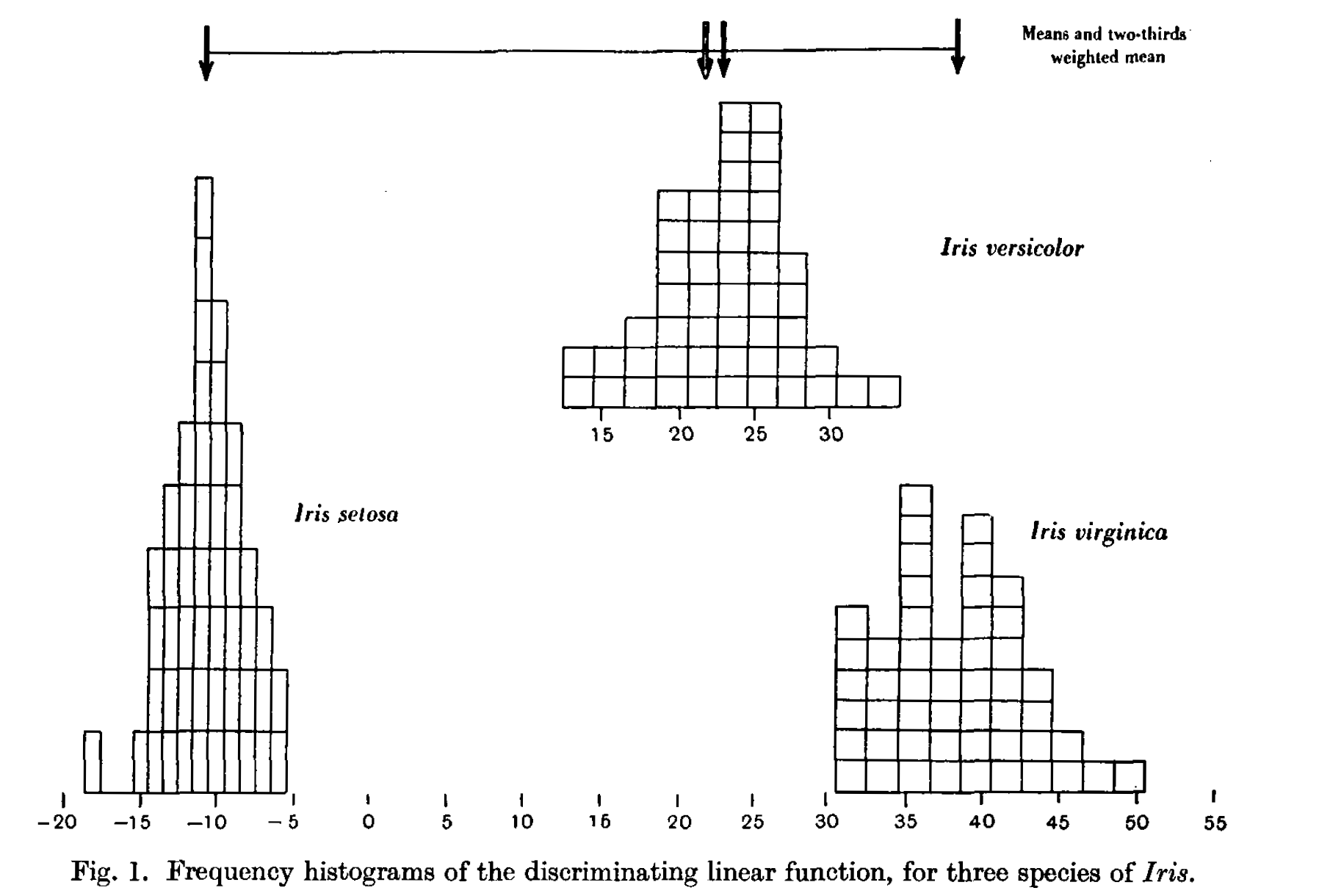
Fisher, R. A. 1936. The use of multiple measurements in taxonomic problems. Annals of Eugenics 7:179-188

Slide 8
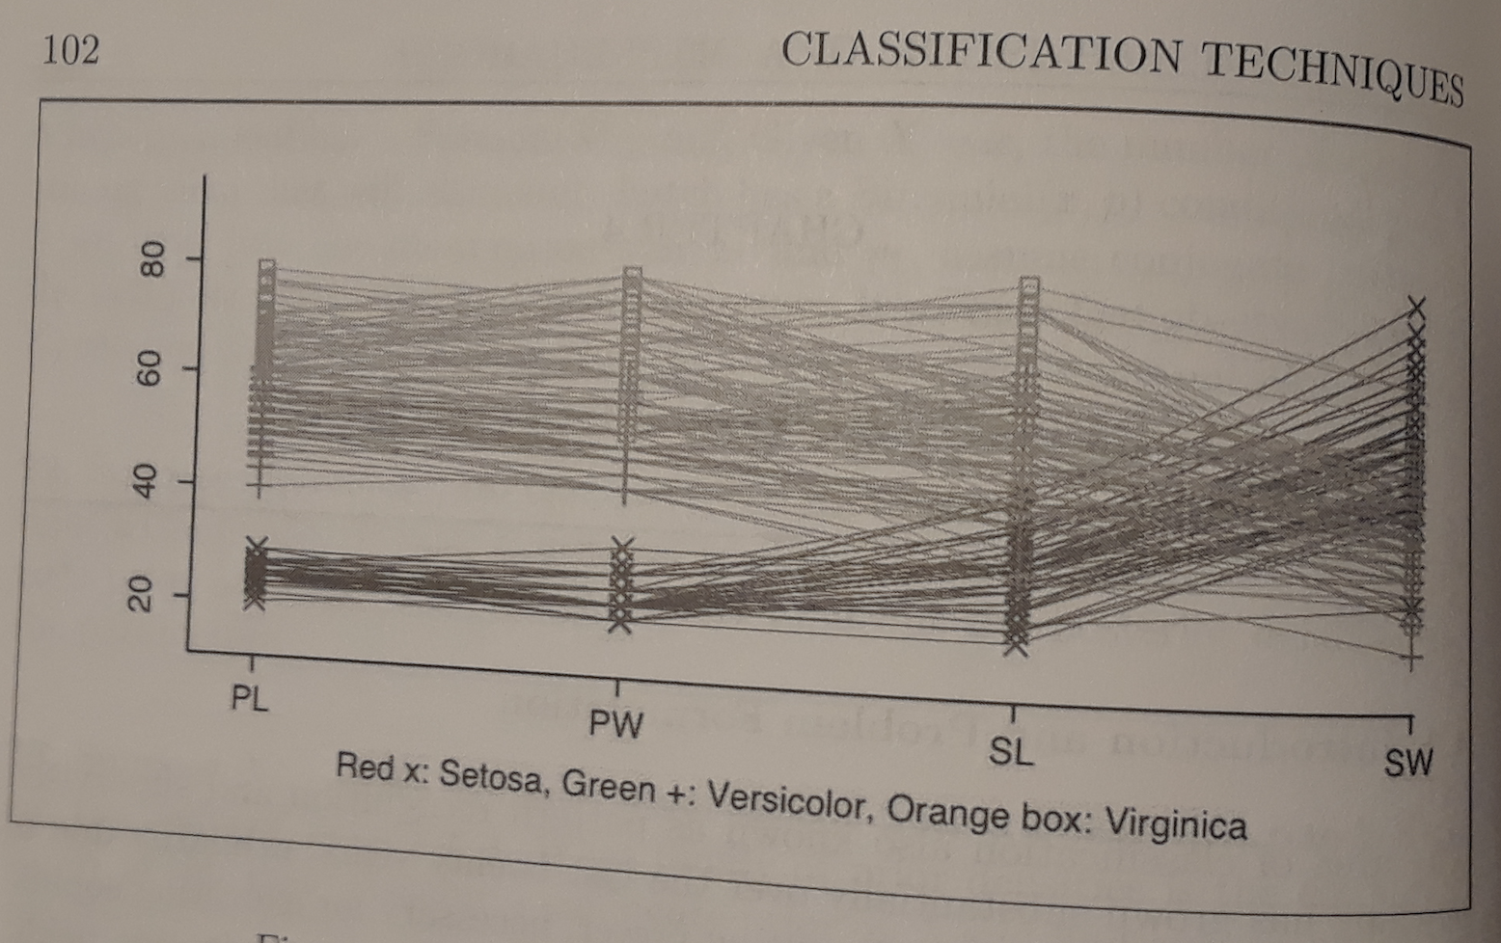
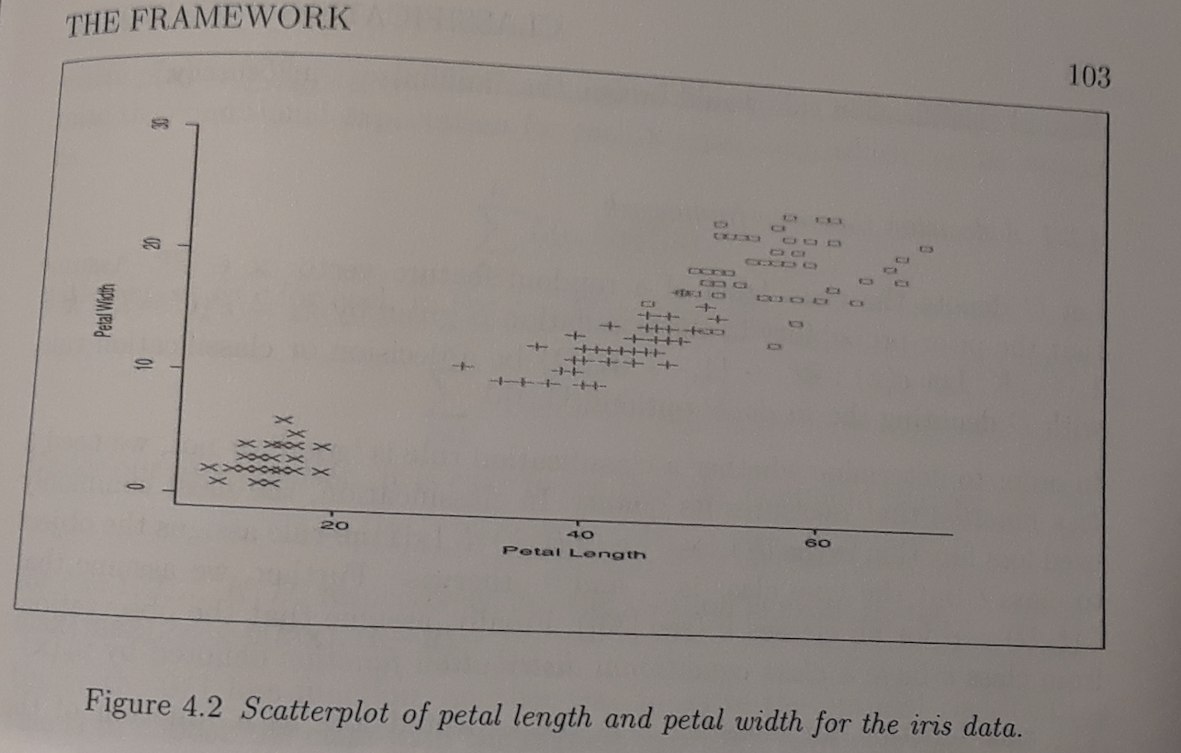
Graphs of Iris data from Fisher 1936 in Chapter 4 of Mitra et al. Introdction to Machine Learning and Bioinformatics

Slide 9
Methods used in ecological data for classification:
The method Fisher developed is called discriminant analysis – it assigns objects to classes that are defined in advance (e.g. the 3 species of iris) and uses linear combinations of the observations on each object to separate the groups based on, as Fisher put it “maximize the ratio of the difference of the specific means to the standard deviations within species”.
Cluster analysis takes a set of observations each with a vector of continuous variables, and segregates these into groups. A few different approaches used in ecology in particular are:

Slide 10
Methods used in ecological data for classification:
agglomerative clustering in which the observations are grouped into successively larger clusters until a single cluster is obtained
divisive clustering starts with all the observations in one group and successively splitting them into smaller clusters until each observation is in its own cluster. In both cases, a rule is used to choose the appropriate number of clusters.
K-means clustering specifies a number of clusters and then assigns objects to clusters so that all objects within one cluster are closer to each other (so this requires a distance metric) than they are to objects within the other clusters – it minimizes the sums of squares from each object to the centroid of its cluster

Slide 11
Example classification problem in a Bayesian Decision Framework (1)
Here a decision rule is one which assigns objects to particular classes. So think of a parameter θ as specifying which group is assigned, and the problem is to decide how to classify a new observation X to place the object it measures in a class. We will consider a discrete case where the set of classes is fixed as
𝚯 = {θ₀, θ₁, …, θ_{p}}
And suppose the set of possible actions is also discrete with the action being to assign an object to one of the p+1 possible values in 𝚯

Slide 12
Example classification problem in a Bayesian Decision Framework (2)
Remember in the Bayesian perspective we view θ as chosen from a random variable θ with P_{θ}(X) giving the conditional distribution of X given θ = θ and
R(θ, 𝛿) = E[l(θ, 𝛿(X)) | θ = θ] is the expected loss if the decision rule is 𝛿 and θ = θ
Taking the expected loss across the distribution of θ gives the Bayes risk
r(𝛿) = E[R(θ, 𝛿)] = E[ E[l(θ, 𝛿(X)) | θ = θ]] = E[l(θ, 𝛿(X))]
If there is a rule 𝛿* which minimizes the Bayes risk it is called a Bayes rule
r(𝛿*) = min_{𝛿} r(𝛿)

Slide 13
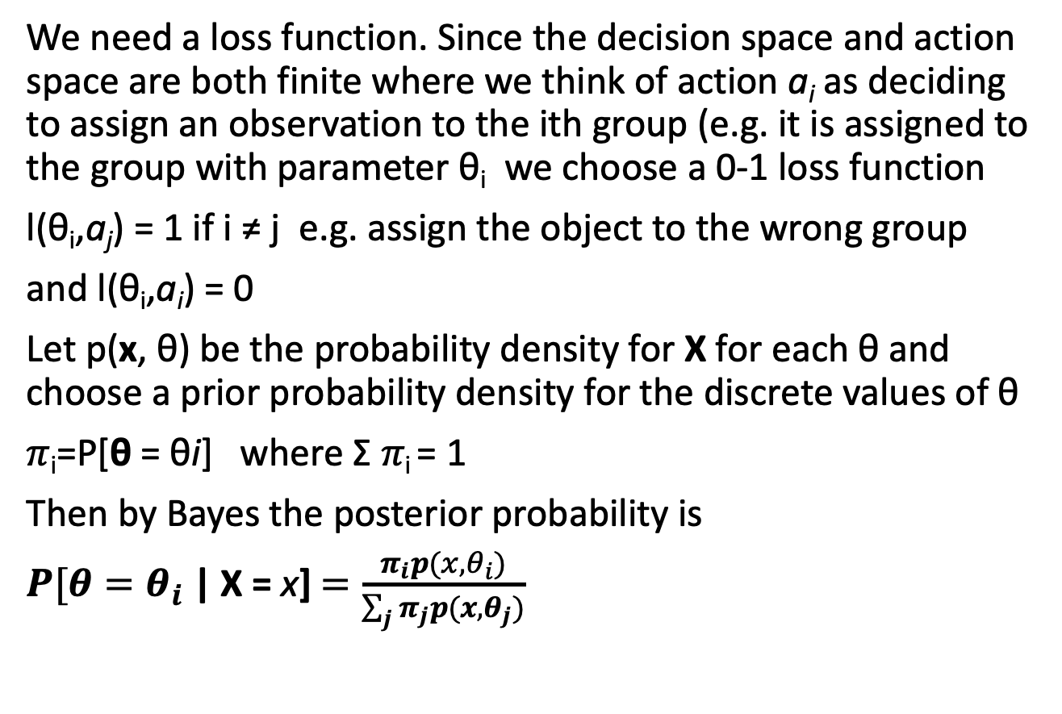
Example classification problem in a Bayesian Decision Framework (3)
We need a loss function. Since the decision space and action space are both finite where we think of action a_{i} as deciding to assign an observation to the ith group (e.g. it is assigned to the group with parameter θ_{i} we choose a 0-1 loss function
l(θ_{i},a_{j}) = 1 if i ≠ j e.g. assign the object to the wrong group
and l(θ_{i},a_{i}) = 0
Let p(x, θ) be the probability density for X for each θ and choose a prior probability density for the discrete values of θ
𝜋_{i}=P[θ = θi] where Σ 𝜋_{i} = 1
Then by Bayes the posterior probability is
$P[θ=θ_{i}$ | X = x] $=\frac{π_{i}p(x,θ_{i})}{\sum_{j}{π_{j}p(x,θ_{j})}}$

Slide 14
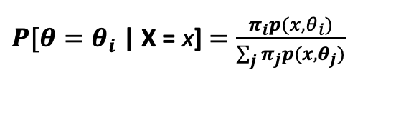
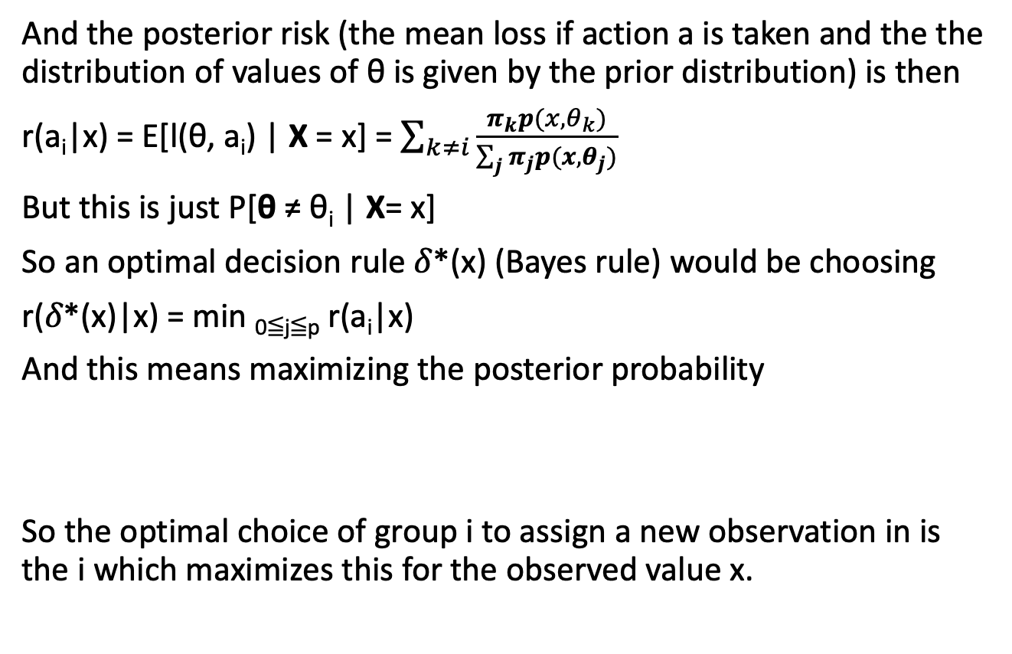
Example classification problem in a Bayesian Decision Framework (4)
And the posterior risk (the mean loss if action a is taken and the the distribution of values of θ is given by the prior distribution) is then
r(a_{i}|x) = E[l(θ, a_{i}) | X = x] = $\sum_{k≠i}{\frac{π_{k}p(x,θ_{k})}{\sum_{j}{π_{j}p(x,θ_{j})}}}$
But this is just P[θ ≠ θ_{i} | X= x]
So an optimal decision rule 𝛿*(x) (Bayes rule) would be choosing
r(𝛿*(x)|x) = min _{0≦j≦p} r(a_{i}|x)
And this means maximizing the posterior probability
So the optimal choice of group i to assign a new observation in is the i which maximizes this for the observed value x.
$P[θ=θ_{i}$ | X = x] $=\frac{π_{i}p(x,θ_{i})}{\sum_{j}{π_{j}p(x,θ_{j})}}$

