Slide 1
Math/EEB 589 - Mathematics of Machine Learning Methods in Ecology and Environmental Science
Louis Gross – Sept 3, 2020
Major classes of problems addressed using machine learning:
Classification - specifies the class to which data elements belong, so this inherently involves “splitting” data into classes and may involve some form of clustering technique to do so. The classic phylogeny problem is an example – assigning organisms to a grouping based on ancestral relationships, that accounts for morphology, development, dating and genetics. Another set of problems involves classifying images (e.g. faces, “dog or cat”, camera traps), classifying landscapes based on remote sensing information, etc.
Regression (or more generally, function approximation) – models a target prediction as a response variable based on a set of inputs (covariates or predictors) and is usually included as a technique in supervised learning. In addition to use for predicting data values from a new set of inputs, it can be used to analyze the behavior of the data (relation between response and inputs) and to determine the relative importance of inputs to the response. This is one aspect of the “model selection” problem - choosing an appropriate statistical model for a set of data, based on the objectives for doing the modeling.

Slide 2
Major classes of problems addressed using machine learning:
Anomaly detection – identifying items or events that do not conform with an expected pattern in a broad data set. Detection of outlier data may be important as these may have large impact which biases the results of analysis methods. Extreme weather events, rare behaviors of individuals in a population, identifying “superspreaders” for a disease .
State prediction or forecasting – projecting outcomes based on properties of data for new experiments or time-dependent conditions. Prediction, projection and forecasting are not equivalent concepts. Forecasting inherently includes communicating uncertainty. Ecological forecasting is an example in which future trajectories of a natural system are projected based on current conditions and assumptions about future environment.
Dimensionality reduction – identifying a more compact representation of a data set without a great loss of information. Principle components analysis is an example which develops new combinations of input variables that most effectively characterize the variability in a response variable of interest.

Slide 3
Short annotations of articles included on the references:
Lefcheck 2015 Blog post that gives a very personal perspective on some standard ecological data set questions and some examples using R with emphasis on CART (classification and regression trees) and random forest approaches.
Christin et al. 2019. Focus on deep learning methods in application to species identification, classification of animal behavior, and biodiversity estimation with examples at many scales and flowchart for process of deep learning

Slide 4
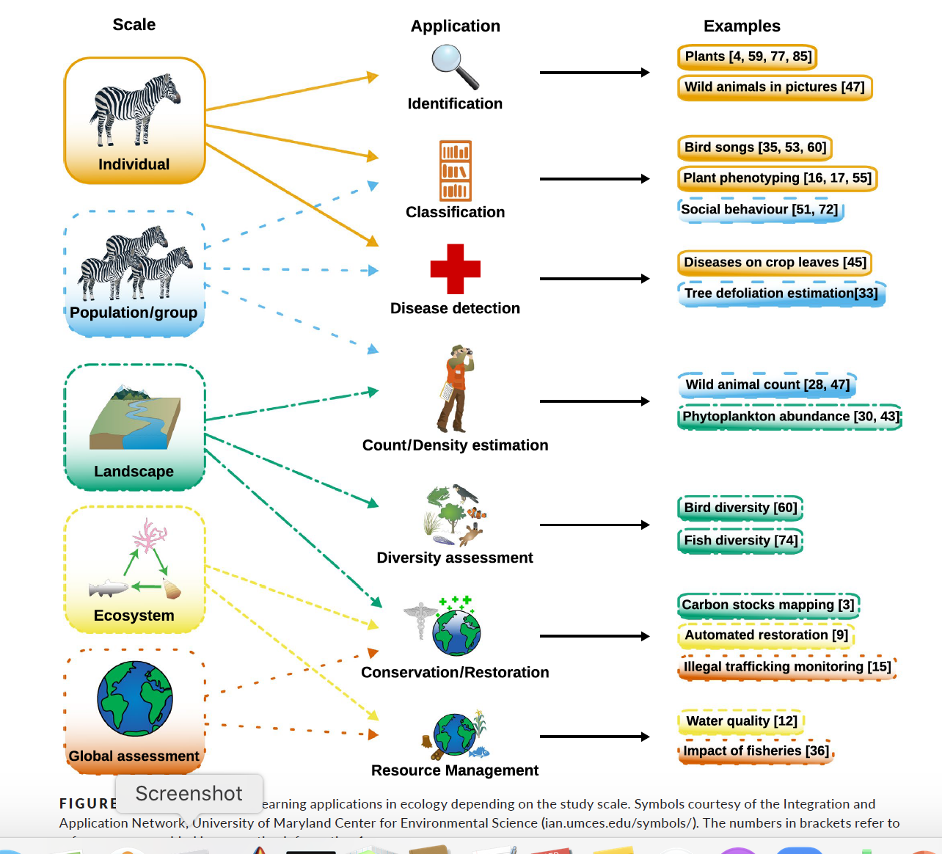
Christin et al. 2019.

Slide 5
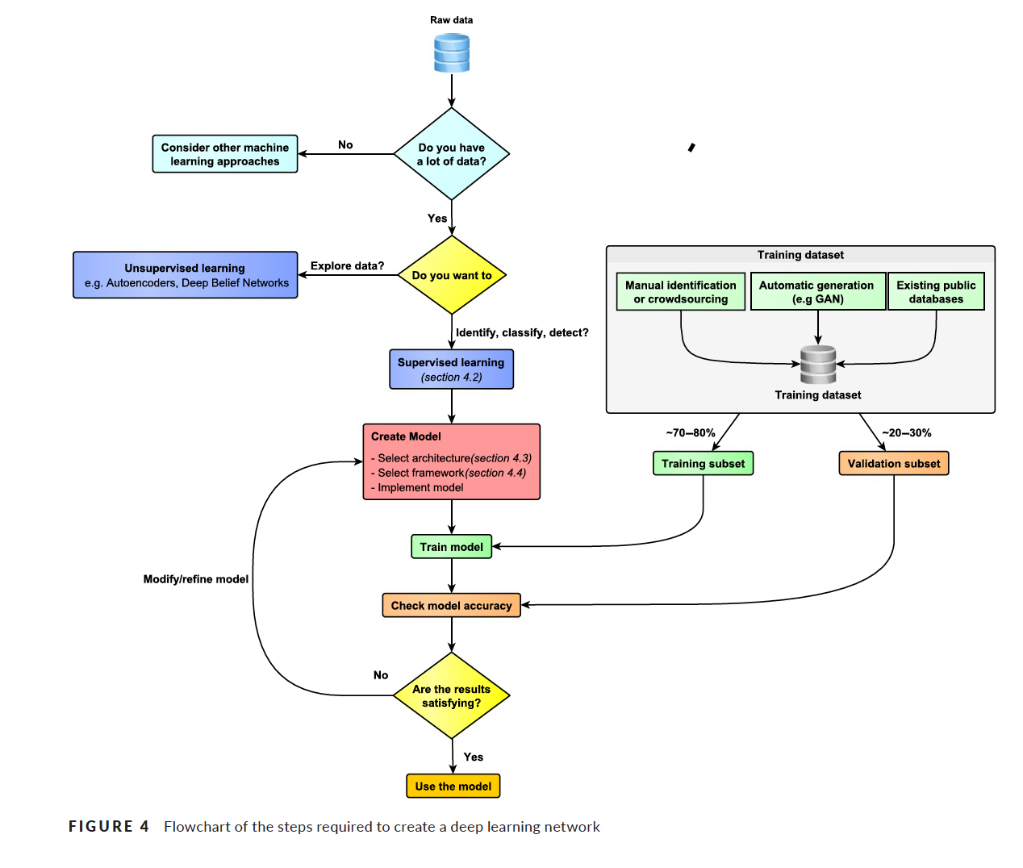
Christin et al. 2019.

Slide 6
Short annotations of articles included on the references:
Lefcheck 2015 Blog post that gives a very personal perspective on some standard ecological data set questions and some examples using R with emphasis on CART (classification and regression trees) and random forest approaches.
Christin et al. 2019. Focus on deep learning methods in application to species identification, classification of animal behavior, and biodiversity estimation with examples at many scales and flowchart for process of deep learning
Petersen et al. 2019. Blog post that illustrates briefly the use of machine learning to analyze images with focus on the Serengeti and citizen science efforts to classify millions of these images for many species.
Peters et al. 2014. Present their suggested procedure for a KLAS (Knowledge Learning and Analysis System as a general framework for knowledge generation from big data and contrast their suggestions with classic hypothetico deductive methods.

Slide 7
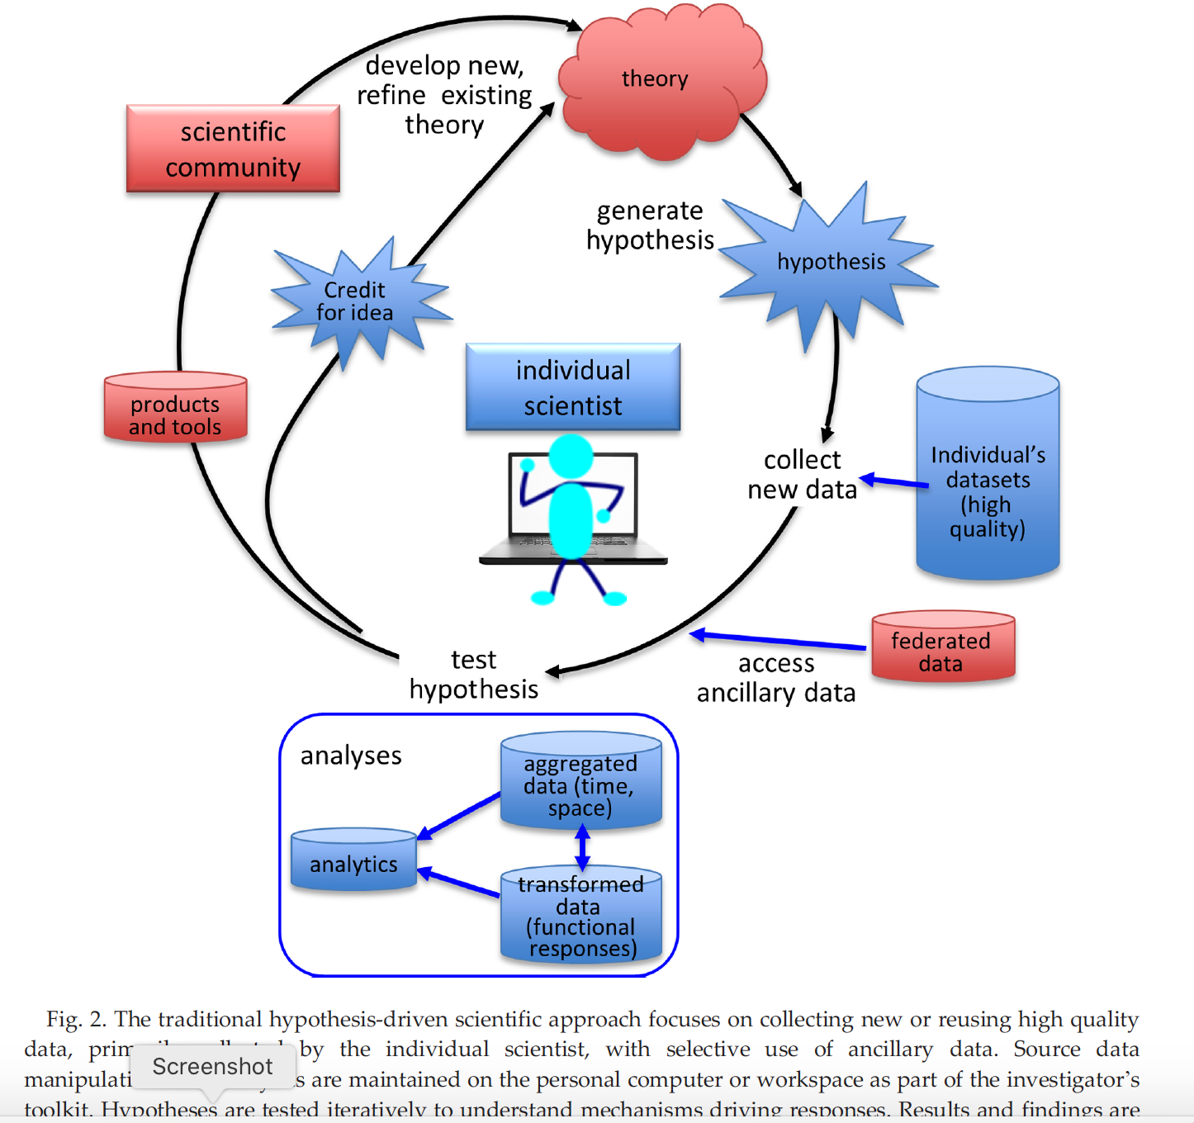
Peters et al. 2014

Slide 8
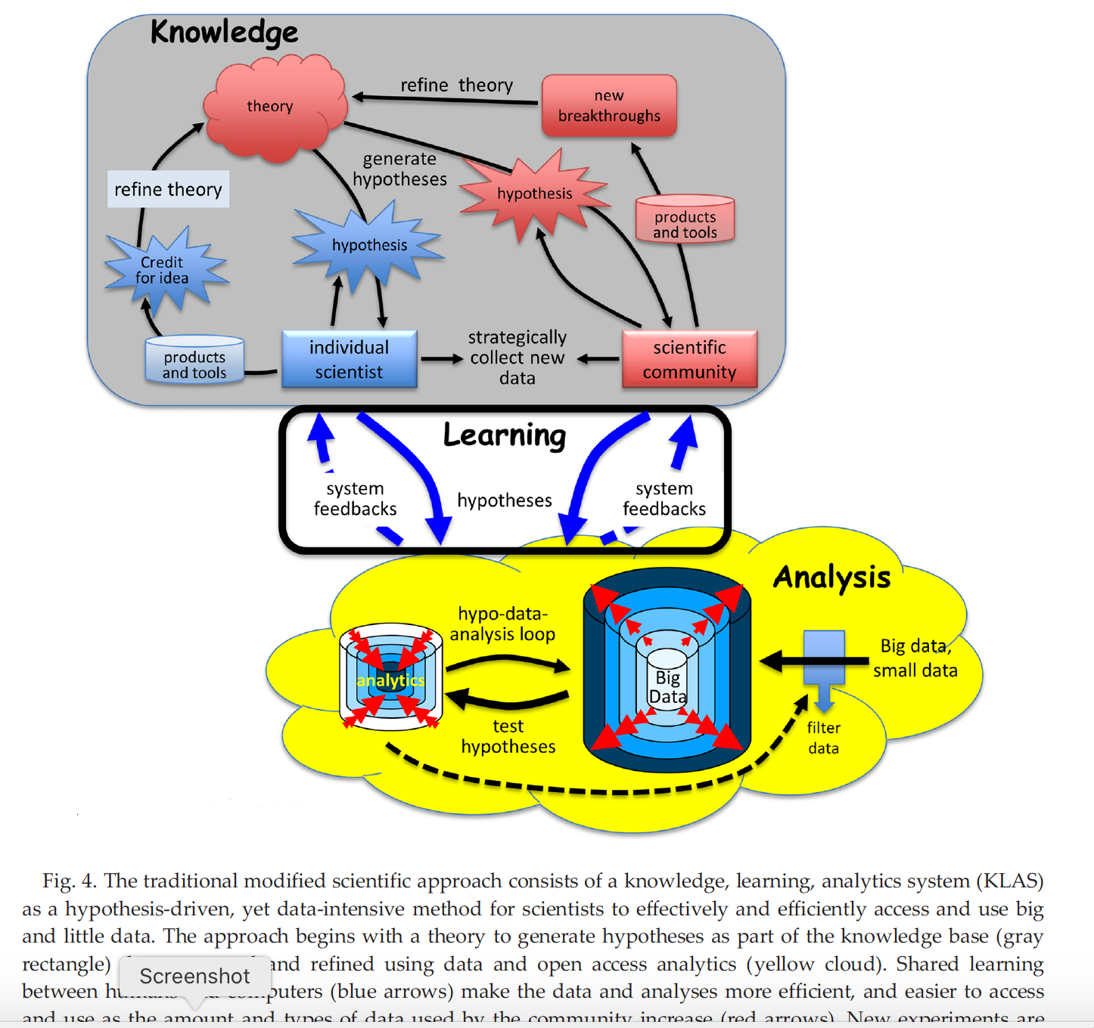
Peters et al. 2014

Slide 9
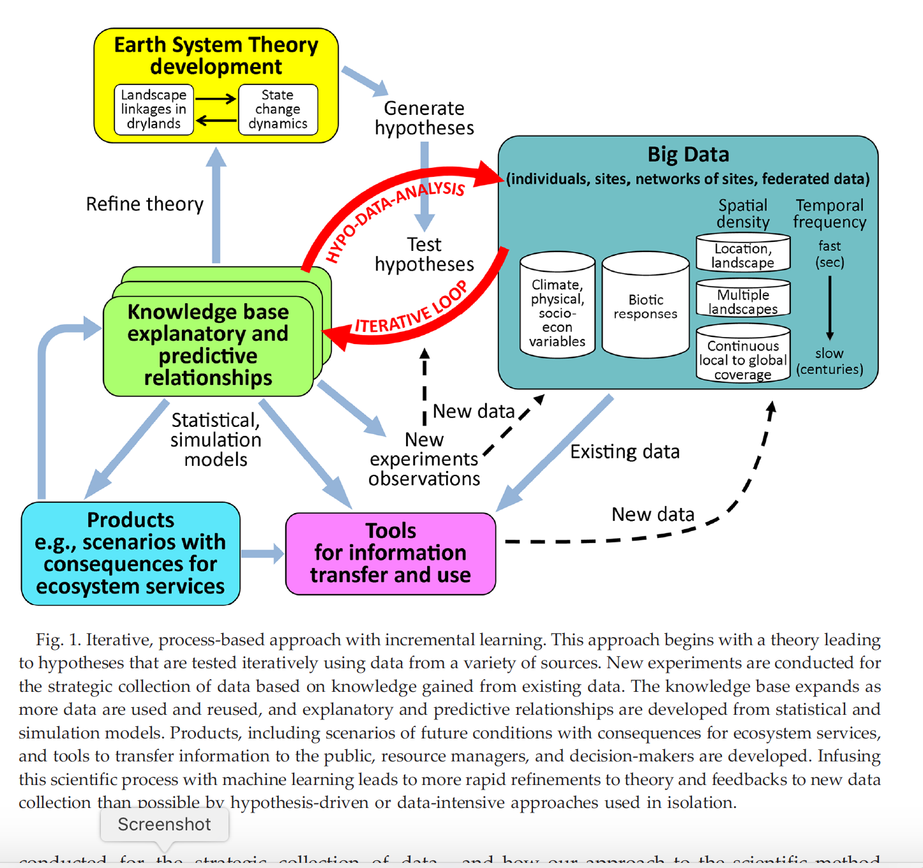
Peters et al. 2014

Slide 10
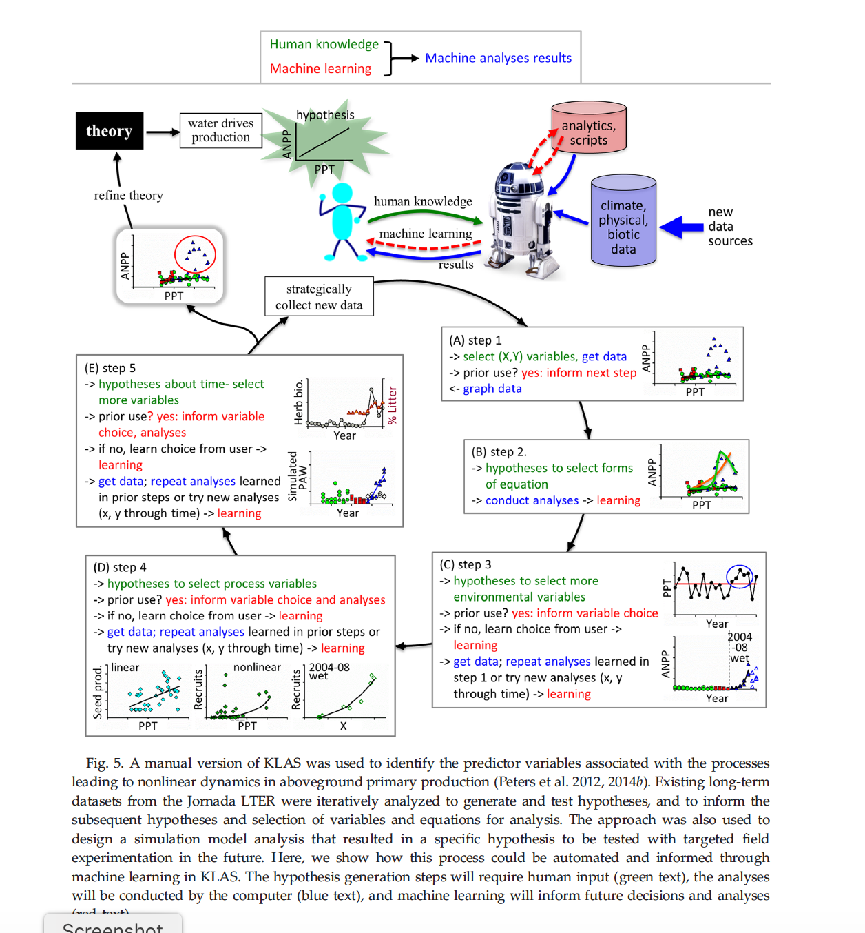
Peters et al. 2014

Slide 11
Short annotations of articles included on the references:
Thessen. 2016. Very quick summary of main tasks of machine learning, limitations, and methods (tree-based methods, artificial neural nets, support vector machines, genetic algorithms, fuzzy inference systems, Bayesian methods) with example of application to species distribution models and forecasting.
Reichstein et al. 2019. Review of big data and deep learning with emphasis on earth science examples. Good summary of definitions, challenges of implementing machine learning and discussion of hybrid modeling that is a mixture of process models and machine learning methods.

Slide 12
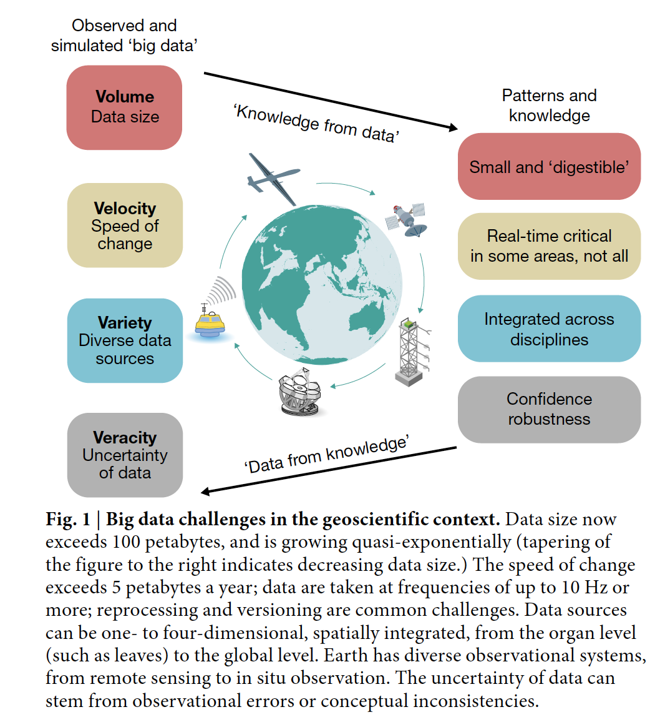
Reichstein et al. 2019

Slide 13
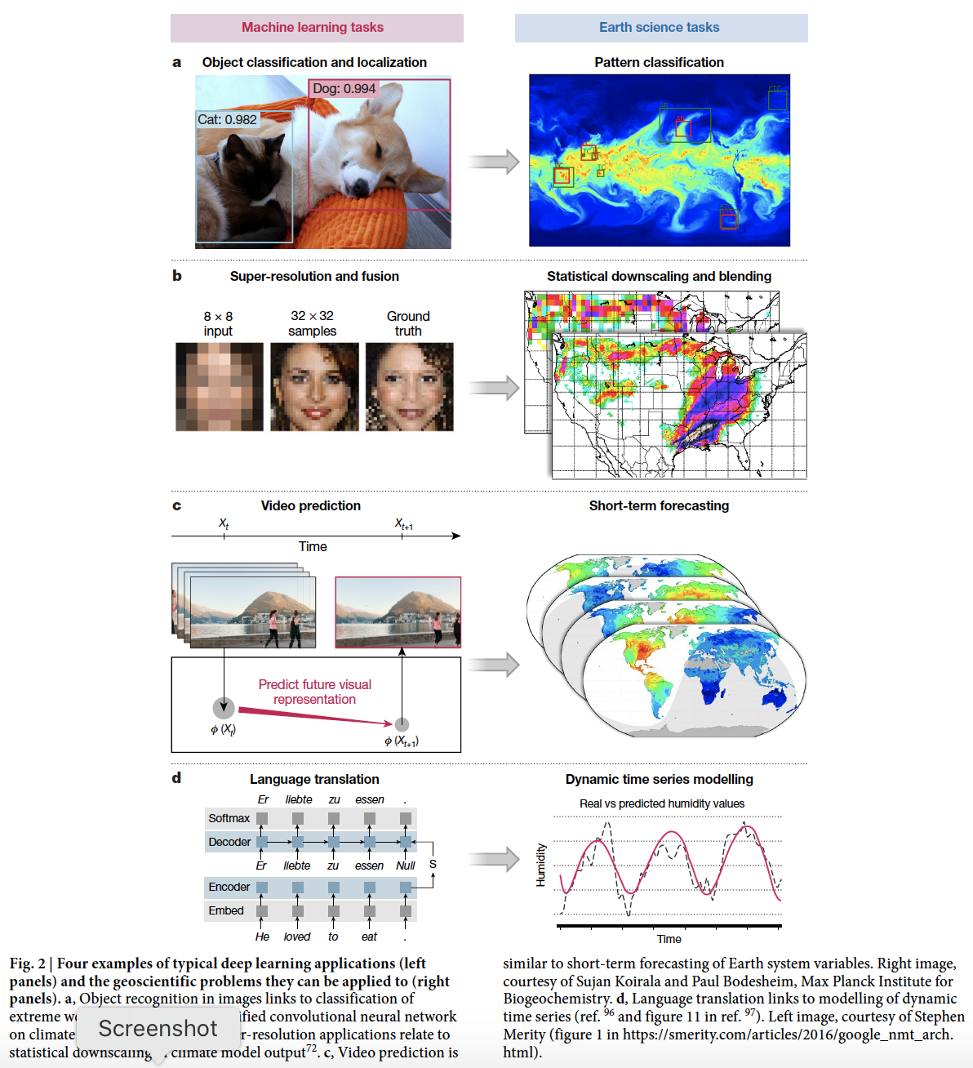
Reichstein et al. 2019

Slide 14
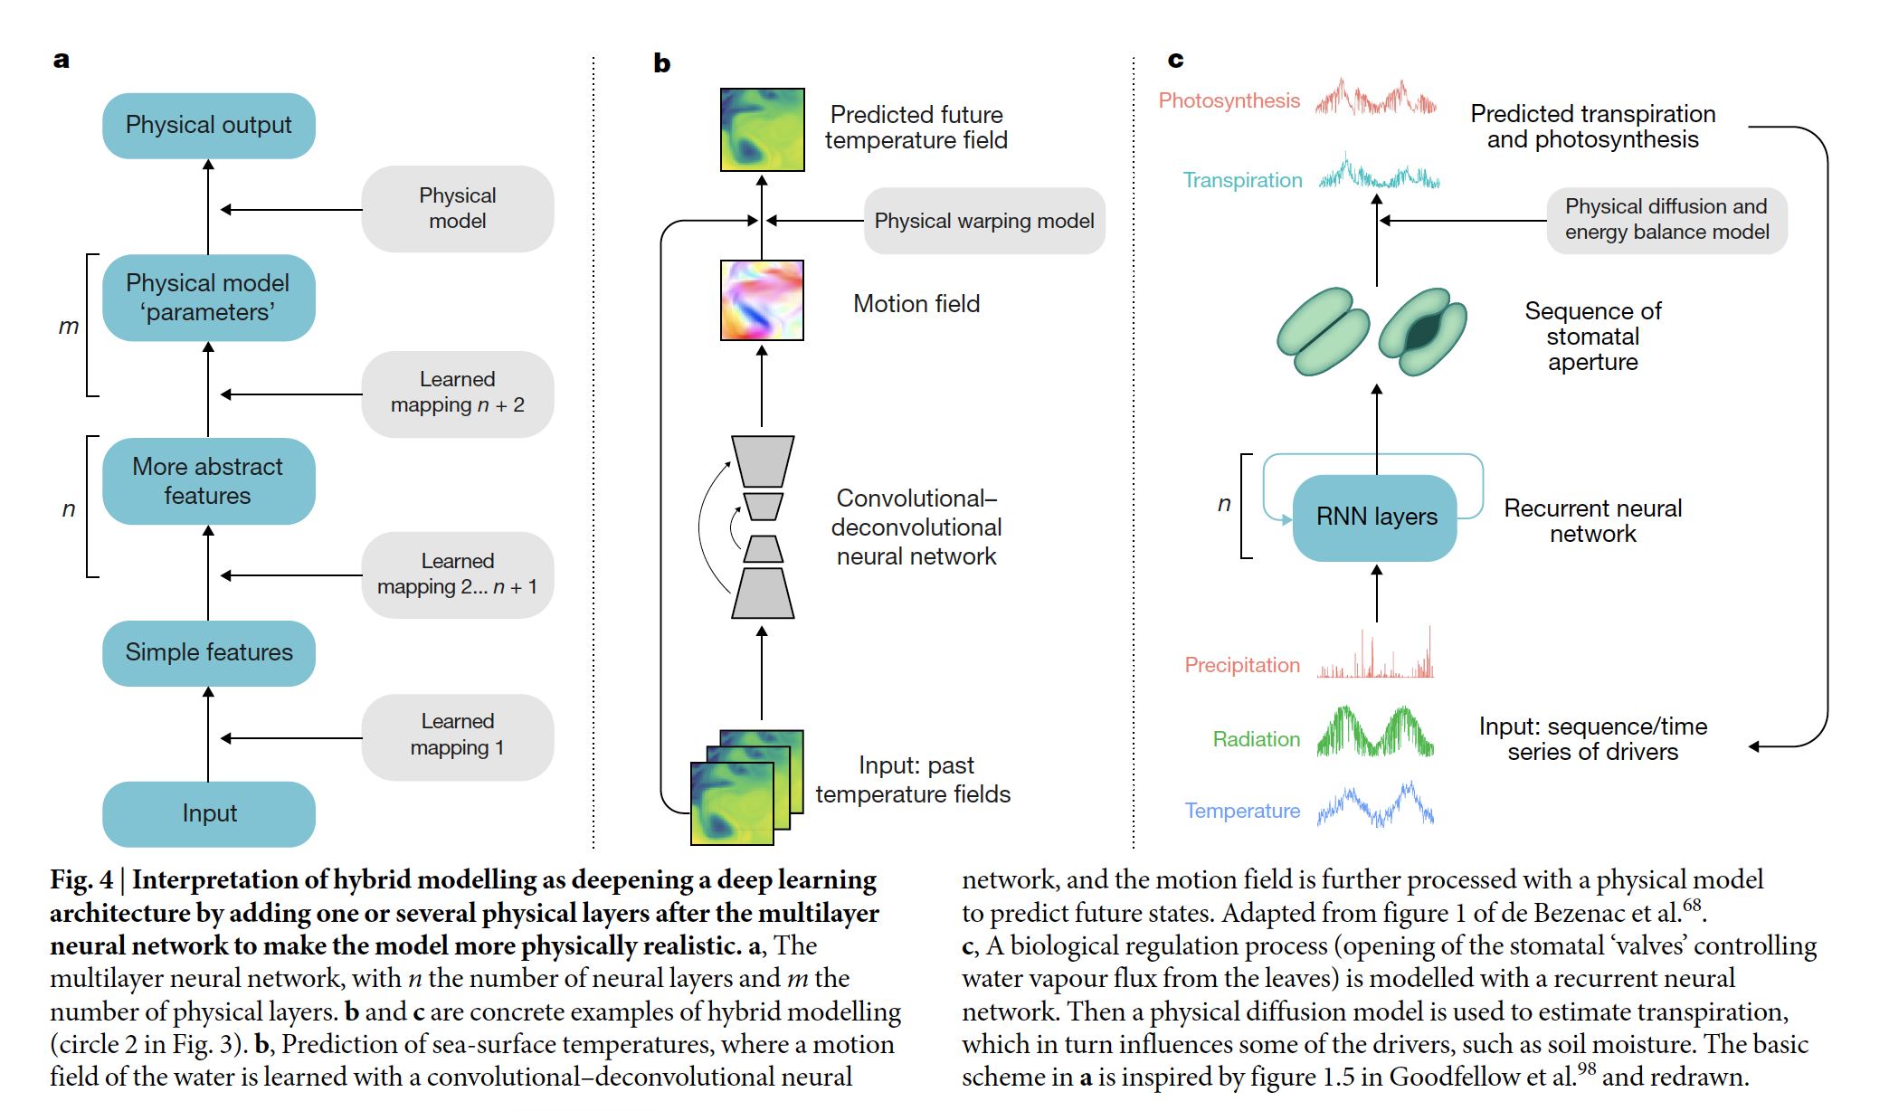
Reichstein et al. 2019

