Slide 1
Math/EEB 589 - Mathematics of Machine Learning Methods in Ecology and Environmental Science
Short annotations (continued) of articles included on the references:
Feng et al. 2020. Illustrates the application of deep learning methods to better fit a very detailed soil organic carbon model across the US. The model is a large system of differential equations and they use Markov Chain Monte Carlo methods to estimate a large collection of parameters using several methods including neural nets.

Slide 2

Feng et al. 2020

Slide 3

Feng et al. 2020

Slide 4
Short annotations (continued) of articles included on the references:
Tabak et al. 2018. Used a convolutional neural net approach to analyze millions of wildlife images from camera traps across the US. Developed an R package and their method was highly accurate (over 98% in US images and well over 80% for images from other parts of the world not part of the training set) in identifying correctly the species in camera trap images.
Rammer and Seidl. 2019. Applied deep learning to analyze both short-term infestations and long-term outbreaks of a harmful insect (bark beetle) in the Czech Republic/ Germany. Includes a supplement with a summary of deep learning in eclogy.
Soltis et al. 2020. Summarizes two special issues of the journal Applications in Plant Sciences that include applications of machine learning to many problems in plant biology including analysis and classification of herbarium specimens, identification of phenological phase.
Pelletier et al. 2018. Uses machine learning methods to analyze and estimate conservation risk for thousands of land plant species across the world based on georeferenced data for > 150K species using random forest methods.

Slide 5
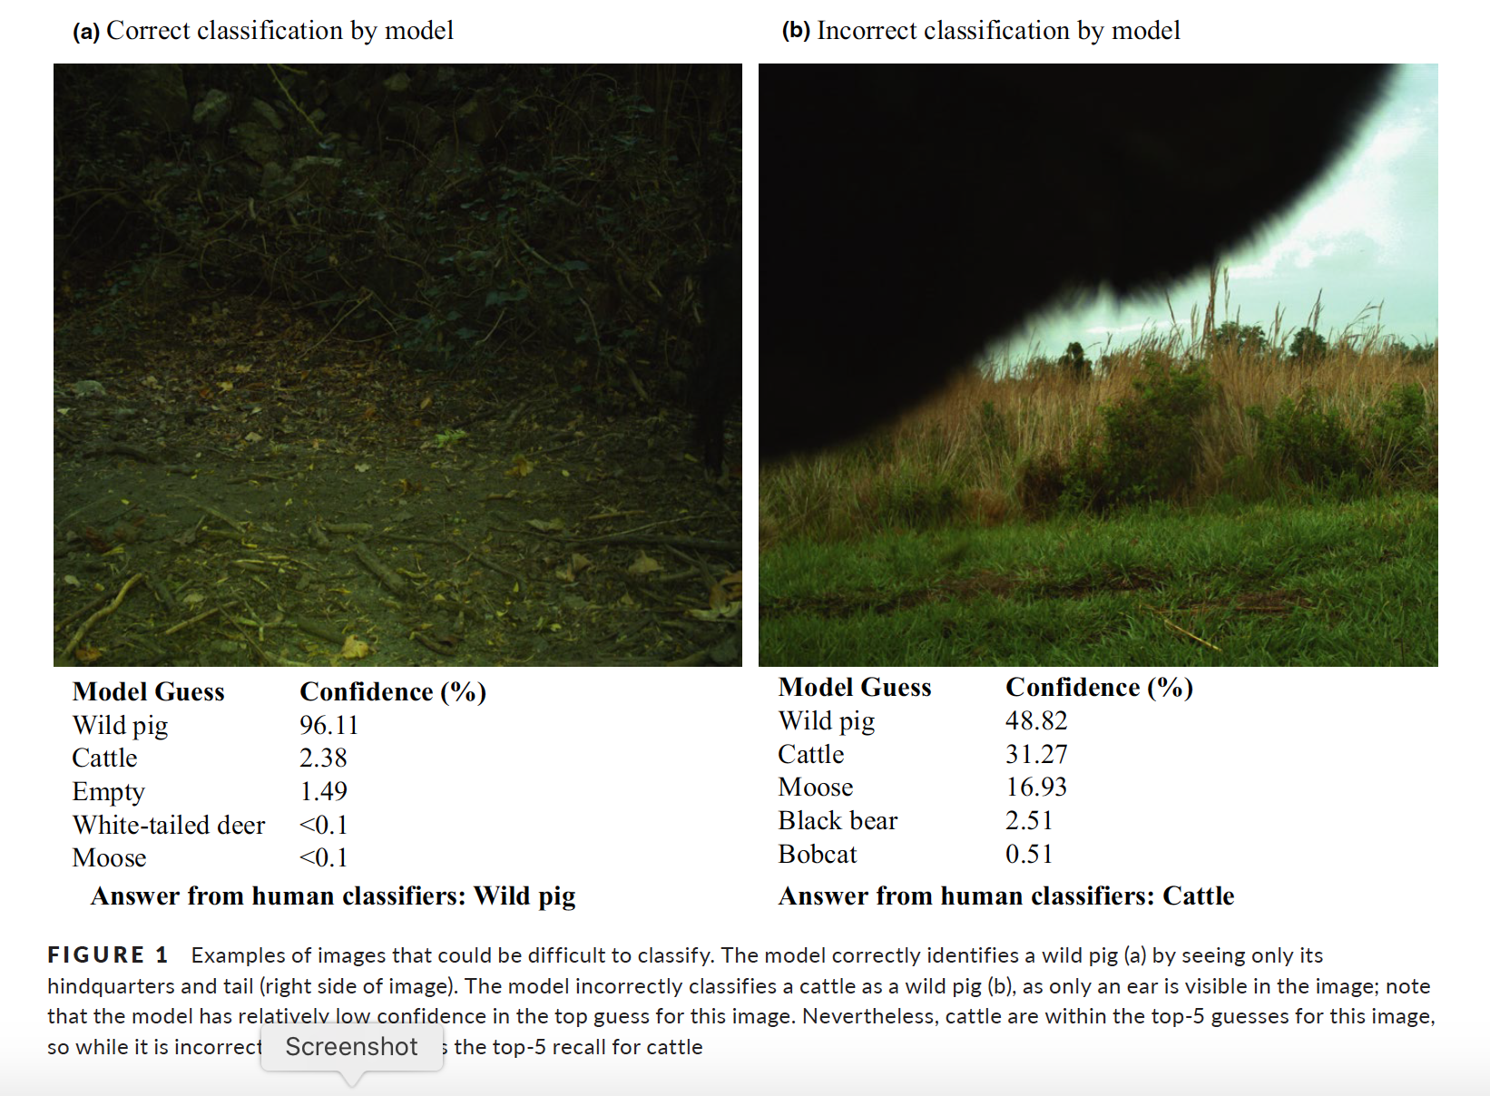
Tabak et al. 2018

Slide 6
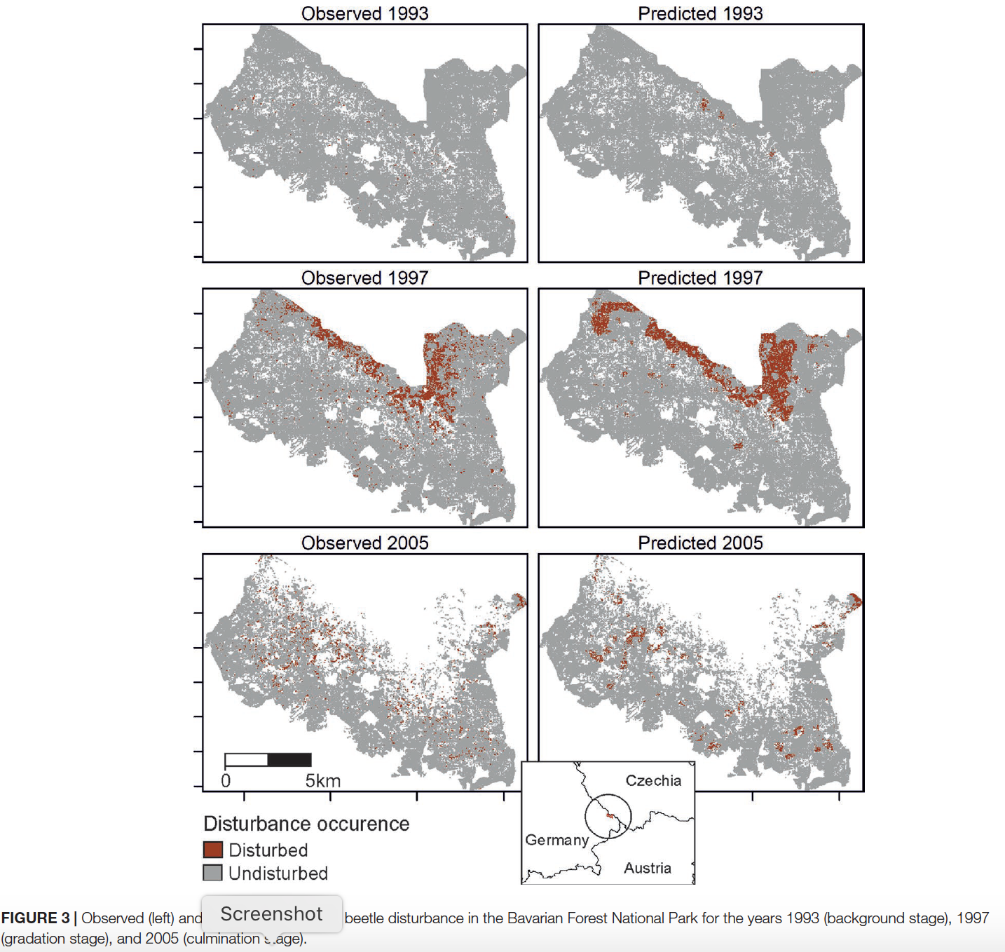
Rammer and Seidle. 2019

Slide 7

Pelletier et al. 2018

Slide 8
Decision Theory and Machine Learning – some references on decision theory
Berger, J. O. 1985. Statistical Decision Theory and Bayesian Analysis. Springer-Verlag, NY
Bickel, Peter J. and Kjell A. Doksum. 1977. Mathematical Statistics: Basic Ideas and Selected Topics. Holden-Day, San Francisco, CA.
Luce, R. Duncan and Howard Raiffa. 1957. Games and Decisions: Introduction and Critical Survey. Wiley, NY.
Wilks, Samuel SD. 1963. Mathematical Statistics. Wiley, NY.

Slide 9
Decision Theory and Machine Learning
Decision theory – general approach to making a choice among alternatives and if this involves uncertainty it is closely connected to inferential statistics and hypothesis testing. The key notion is to optimize a choice under uncertainty, which implies there is a metric for how “good” a particular choice is.
Idea is that there is a decision d leading to an outcome q and a pdf for outcomes conditional on d , p(q|d) and a utility function u(q) that assigns “value” to an outcome. If q is in the future then there is often some discounting included in u(q) (e.g. e^{-rt} ). This can be viewed in a Bayesian framework with a prior distribution assigned to outcomes which are updated by Bayes rule with additional data.
Many environmental management problems can be viewed in this framework – choosing management decisions which affect biodiversity, renewable resources, water quality, etc. Classification in machine learning can be viewed as a decision theory problem – making a decision as to how to classify an organism, landscape pixel, animal image, etc.

Slide 10
General structure of a statistical decision problem
This is viewed as an extension of classical statistics of parameter estimation, hypothesis testing by including a metric for the consequences (loss or cost) of an action affecting observations
Consider a random variable X with distribution depending upon a parameter θ chosen from a space 𝚯, where θ specifies “the true state of nature”. A decision is made by choosing from an action space A, which could be discrete or continuous – e.g. treat for a disease or don’t, fertilize or not, apply y amount of fertilizer, etc.
In hypothesis testing A = {0, 1} where 0 is accept H₀, 1 is reject H₀
In parameter estimation A is often some continuous region or all of ℛ.

Slide 11
General structure of a statistical decision problem
Now define a loss function l(θ,a) which specifies the loss if action a is taken when the true state of nature is θ. l(θ,a) is typically assumed to be ≥ 0. Examples are
Estimation of q(θ): Quadratic loss l(θ,a) = (q(θ) – a)²
Hypothesis testing: θ ∈ 𝚯_{o} vs θ ∈ 𝚯₁
0-1 loss so l(θ,a) = 0 if θ ∈ 𝚯_{a} (decision is correct) or
l(θ,a) = 1 otherwise (decision is incorrect)
Next we need a process to use data to make a decision which leads to defining a decision rule 𝛿(x): ℛ^{n}→A which assigns an action a when x is observed. So if θ is the true value of the parameter, then l(θ, 𝛿(X)) is a random variable for the loss and R(θ, 𝛿) = E[l(θ, 𝛿(X))] is the risk function or risk of 𝛿 at θ.

Slide 12
General structure of a statistical decision problem
In the case of quadratic loss, the estimation of q(θ) problem has risk function
R(θ, 𝛿) = E[(𝛿(X)- q(θ))²] which is the mean square error of the estimator 𝛿
In the case of hypothesis testing of θ ∈ 𝚯_{o} vs θ ∈ 𝚯₁ with 0–1 loss then 𝛿 is the critical function of the test (e.g. the indicator function for whether x is in the critical region or not for the test) and
R(θ, 𝛿) = P[𝛿(X) = 1] if θ ∈ 𝚯_{o}
= P[𝛿(X) = 0] if θ ∈ 𝚯₁
So R(θ, 𝛿) gives the probabilities of type 1 and type 2 error in this case

Slide 13
General structure of a statistical decision problem
Comparing procedures leads to the definition that 𝛿 improves a procedure 𝛿’ iff R(θ, 𝛿) ≤ R(θ, 𝛿’) for all θ, with strict inequality for some θ. Note that the decision problem is challenging because the “best” decision may depend upon the state of nature so that the decision rule to choose an action used for one value of θ may have a higher R for a different choice of θ – so finding a uniformly improving decision rule is non-trivial.
There are examples of “classes” of decision rules 𝛿 for which it can be shown that a decision procedure improves all others within a class. Alternatively, there are comparison procedures based on global criteria (e.g. not restricted to a particular class) – Bayesian approaches give one such example, and minimax procedures are another approach.

Slide 14
General structure of a statistical decision problem
Bayesian perspective:
Here we view θ as chosen from a random variable θ with P_{θ}(X) giving the conditional distribution of X given θ = θ. So here
R(θ, 𝛿) = E[l(θ, 𝛿(X)) | θ = θ] is the expected loss if the decision rule is 𝛿 and θ = θ
In the Bayesian perspective we consider the expected loss across the distribution of θ to get the Bayes risk
r(𝛿) = E[R(θ, 𝛿)] = E[ E[l(θ, 𝛿(X)) | θ = θ]] = E[l(θ, 𝛿(X))]
In this framework, 𝛿 is preferable to 𝛿’ iff it has a smaller Bayes risk which means we must be able to calculate the double expectation. If there is a rule 𝛿* which minimizes the Bayes risk it is called a Bayes rule
r(𝛿*) = min_{𝛿} r(𝛿)

Slide 15
General structure of a statistical decision problem
Minimax perspective:
Similar to 2-person game theory notions, we can consider rules that do not consider average risk as the Bayes approach does, but rather consider the worst possible risk and minimize it.
Here 𝛿 is preferred to 𝛿’ iff sup_{θ}R(θ, 𝛿) < sup_{θ}R(θ, 𝛿’)
A decision rule 𝛿* such that
sup_{θ}R(θ, 𝛿*) = inf_{𝛿} sup_{θ}R(θ,𝛿)
is called minimax because it minimizes the maximum risk
This is a very conservative approach because it aims to give maximum protection against the worse that can happen, so it sort of assumes that the parameter value θ is being chosen by a malevolent opponent who knows what decision rule is being used. Assuming nature is malevolent is a rather pessimistic perspective!

Slide 16
General structure of a statistical decision problem
A randomization perspective:
Just as you may be familiar with from the use of mixed strategies in game theory, we can potentially have lower maximum risk by considering a randomized strategy across all possible decisions 𝛿. For simplicity consider the discrete case in which 𝛿 is chosen from some class 𝒟 of all decision procedures and consider a randomized procedure that assigns probability λ_{i} to 𝛿_{i} and define the mean risk to be
R(θ, 𝛿) = Σ λ_{i} R(θ, 𝛿_{i}) and given a prior probability distribution 𝜋 on 𝚯
the Bayes risk of 𝛿 is r(𝛿) = Σ λ_{i} E[R(θ, 𝛿_{i})]
A randomized Bayes procedure 𝛿* minimizes r(𝛿) among all randomized procedures (e.g. choices of distributions {λ_{i}} and a randomized minimax procedure minimizes max_{θ}R(θ, 𝛿) among all randomized procedures

Slide 17

Limitations of the above approaches to decision
The above methods focus specifically on static problems. Similar to issues in optimal control problems, there is a companion problem of how to use decision theory to analyze dynamic problems. In this case, it requires a stochastic process perspective and the usual approach is to assume that the underlying state variables X are time-dependent Markov processes, with a transition function that is affected by the decisions made – this is Markov Decision Theory. This has been applied extensively in behavioral ecology.
Mangel, Marc and Colin W. Clark. 1989. Dynamic Modeling in Behavioral Ecology. Princeton Univ Press, NJ
Clark, Colin W. and Marc Mangel. 2000. Dynamic State Variable Models in Ecology: Methods and Applications. Oxford Univ. Press, UK.

