Slide 1
Math/EEB 589 - Mathematical Biology Seminar on Spatial Ecology: Integrodifference Equation Models – Spring 2021
Instructor: Louis J. Gross, EEB/Math
The objective of this one-credit-hour seminar is to provide an overview of mathematics and modeling using some alternative methods to account for the spatial heterogeneity of ecological systems, with a focus on integrodifference equations. We will follow in part the text by Frithjof Lutscher on this topic. It is expected that participants registered for credit will take part by summarizing the content in one or more portions of the text, or giving a talk on a subject that is of interest to the participants. Some suggested additional topics are: Next generation matrix methods, Partial Rank correlation coefficients, Latin hypercube sampling, and Sobol sensitivity.
Introductory remarks for first session: January 26, 2021:
Models and trade-offs
Approaches to modeling spatial aspects of ecological systems
Summary of IDEs (taken from article by Kot, Lewis and Neubert)

Slide 2
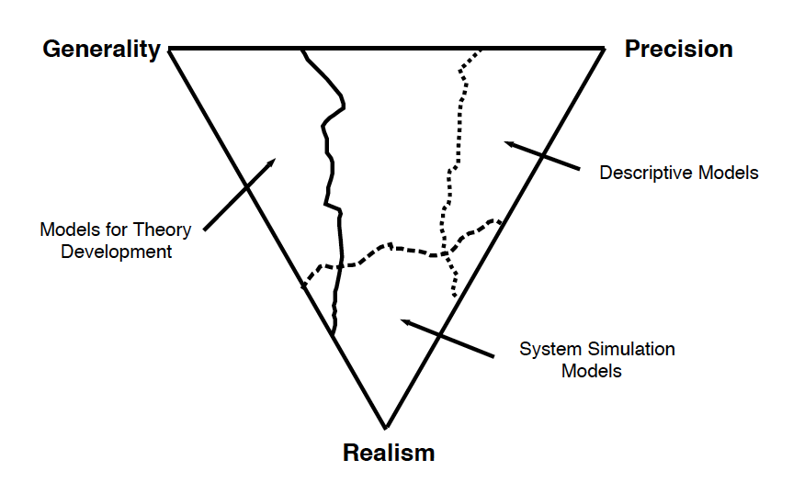
Models and tradeoffs
No one model can do everything
From: Gross, L. J. 2013. Use of Computer Systems and Models. In: Levin S.A. (ed.) Encyclopedia of Biodiversity, Second Edition, Volume 2, pp. 213-220. Academic Press, Waltham, MA.

Slide 3
Alternative Modeling Approaches in Spatial Ecology
Non-spatial – ODE (spatially-implicit)
Discrete space
  Metapopulation (Levins) – p(t) = fraction of occupied patches
  Patch models – Ni(t) = pop density in patch i with no dependence on spatial arrangement of patches
  Spatially-explicit patch models – Ni(t) depend on spatial arrangement of patches
Continuous space
  Continuous time - PDE – reaction diffusion etc.
  Discrete time - Integrodifference equation
ABM –agent-based models – account for behaviors at individual level and associated interactions
Cellular automata – consider general patterns of simple rules that depend upon local and neighboring states – usually discrete in space and time
Interacting particle systems – a continuous-time Markov process that deals with rates of transition of particles on a lattice that interact
Stochastic versions of all above exist (if not already stochastic) and there are a variety of simulation tools which implement some of the above.
Optimal control theory has been developed for some but not all of above

Slide 4
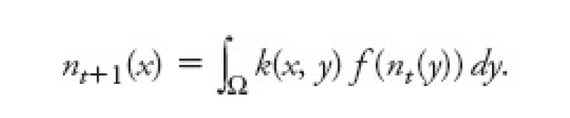
Basics of Integrodifference Equations
Note that the remarks here are taken heavily from Mark Kot, Mark Lewis and Michael Neubert. 2012. Integrodifference Equations, in Encyclopedia of Theoretical Ecology (Alan Hastings and Louis J. Gross (eds.) University of California Press
Objective is to deal with populations/communities with distinct growth and dispersal phases (e.g. annual plants). The method is non-local and treats time as discrete, space as continuous, and state variables as continuous.
General 1-d single, unstructured population model is
Here the population density is n_{t}(x) and the population within a time step first grows according to the f( ) function and then spreads due to the dispersal kernel k( , ).

Slide 5
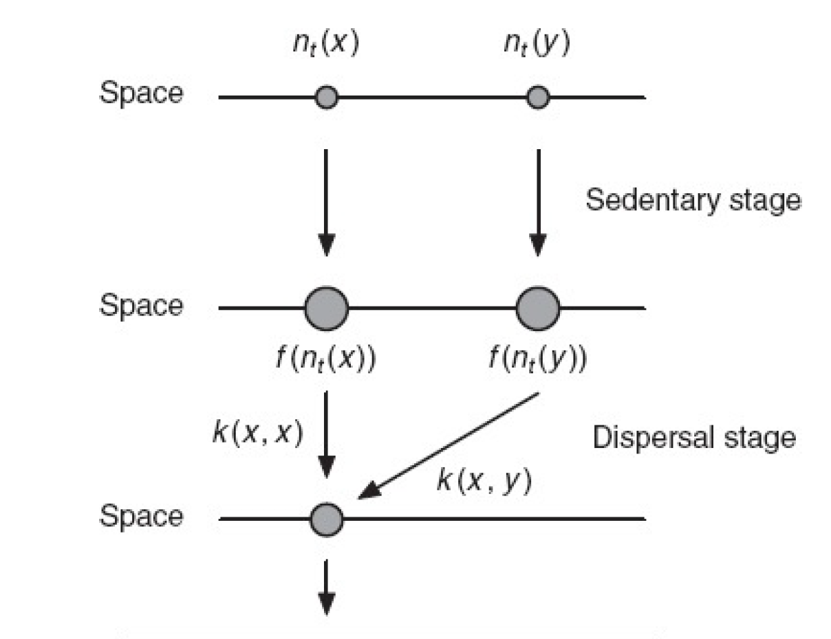
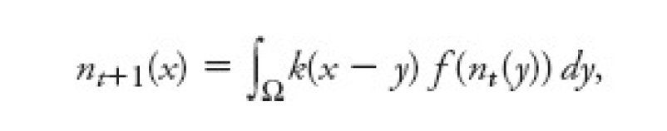
Basics of Integrodifference Equations
The conceptual structure for the 1-d case is
And in the case of dispersal based on distance not explicit location the model becomes a convolution

Slide 6
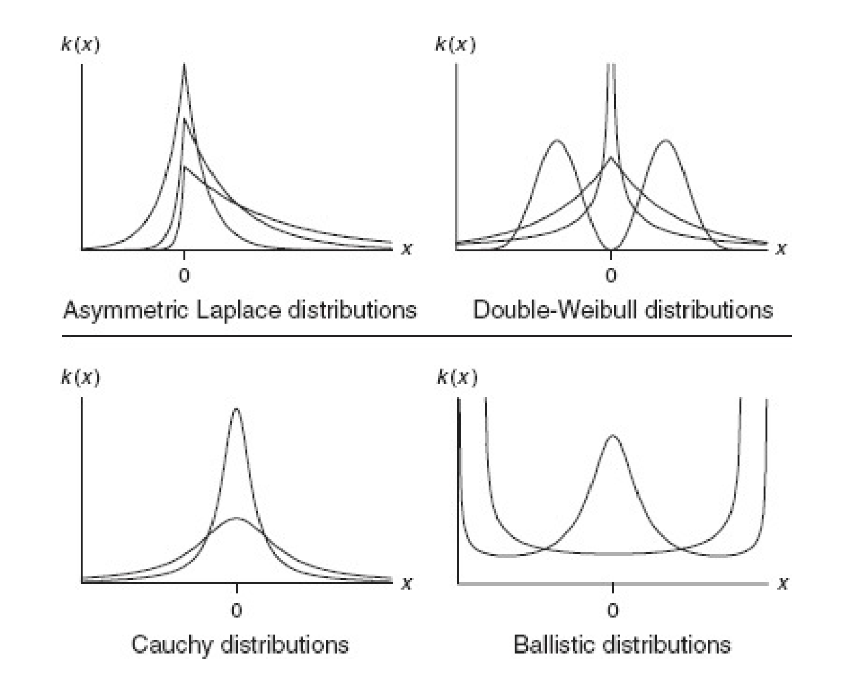
Basics of Integrodifference Equations
There are many possible dispersal kernels
And these can be estimated from seed-shadow data, spore collectors, marked recapture data but are also typically just assumed based upon some understanding of the dispersal nature of the populations (e.g. winged seeds are different from nuts). There are also ways to incorporate directed dispersal due to wind, currents, etc.

Slide 7
Basics of Integrodifference Equations
The key questions addressed by IDEs are similar to those for much of the theoretical work in spatial population modeling:
What spatial factors affect population persistence? Is there a critical patch size that allows a population to persist?
How does a population respond to changing underlying environmental conditions? Under what circumstances can the range of a population shift quickly enough that it can spatially track a changing environmental?
How rapidly does a potentially invasive population spread? This can involve estimating wave speeds.
What types of spatial patterns can arise in the system? Can dispersal of different interacting species destabilize what would otherwise be a stable spatial pattern?
How does age/stage/physiological structure interact with dispersal to affect population persistence or spatial structure? If the stage of an individual affects growth or dispersal how does this affect long-term persistence?
How does the nature of the spatial domain, boundary and initial conditions affect the above?

Slide 8
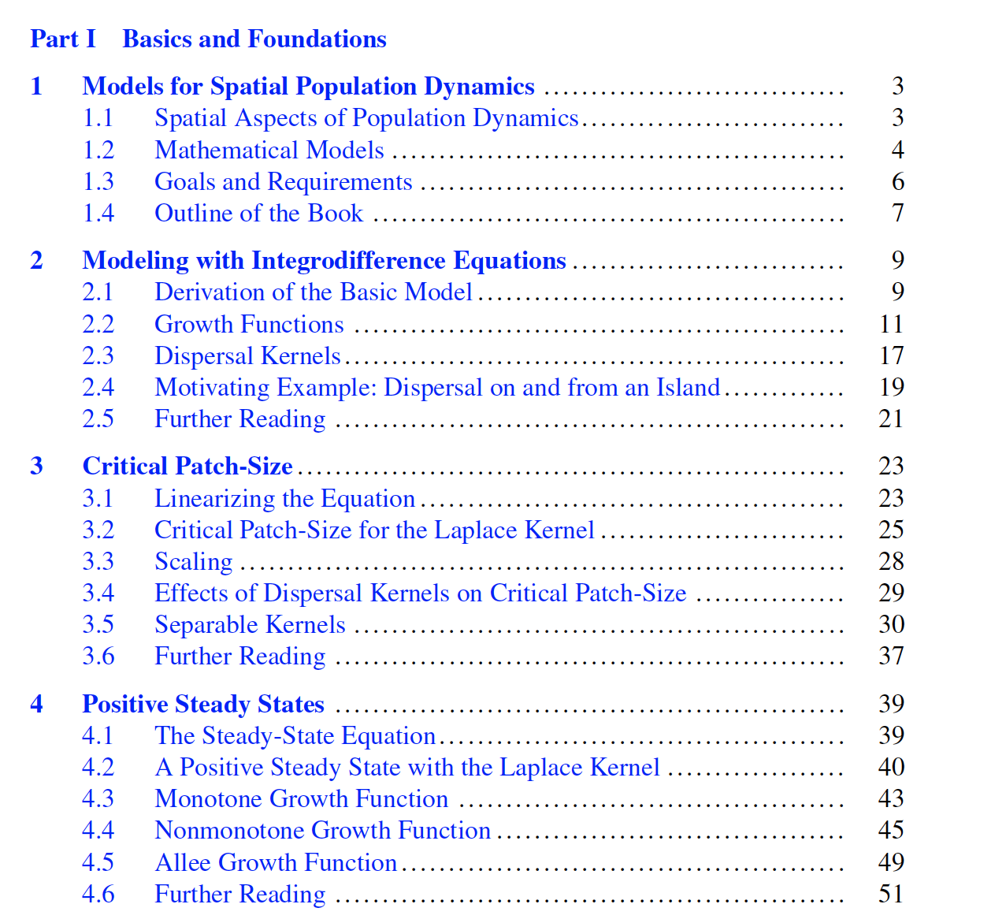
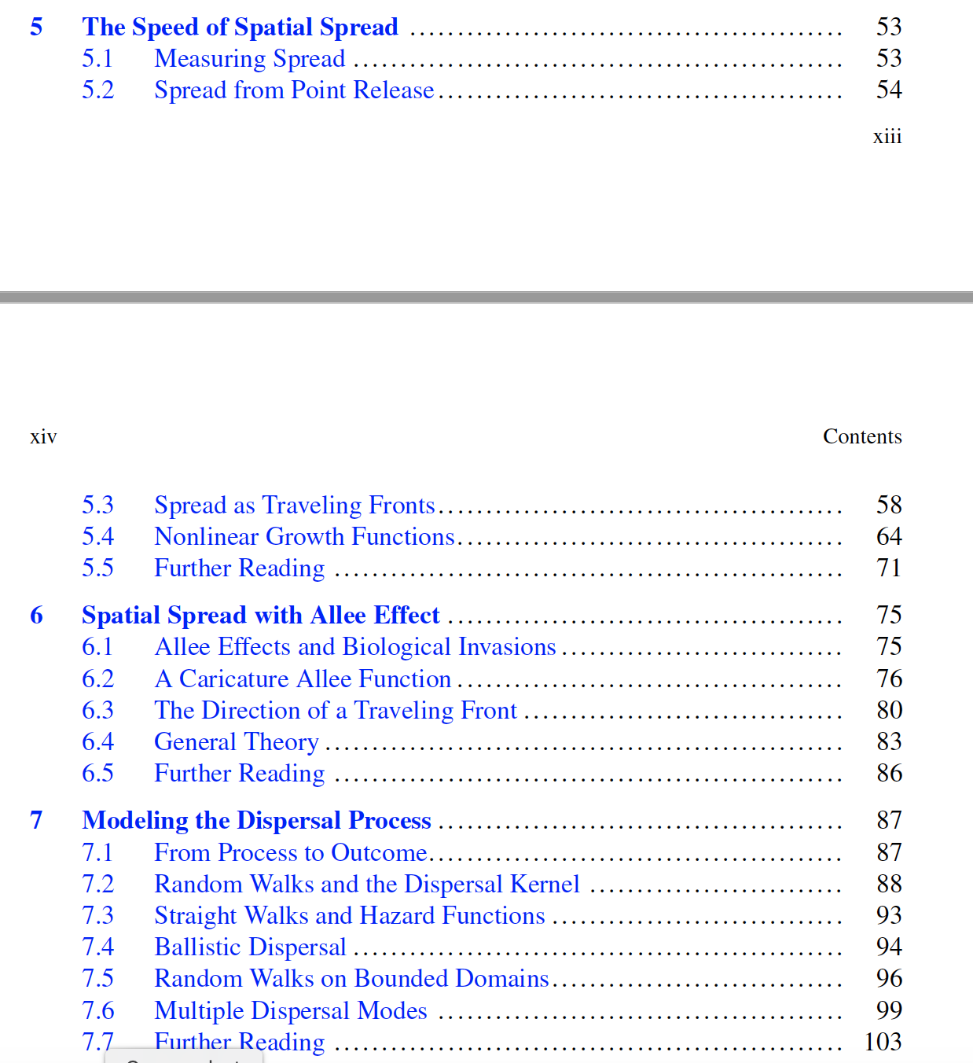
Topics in the text

Slide 9
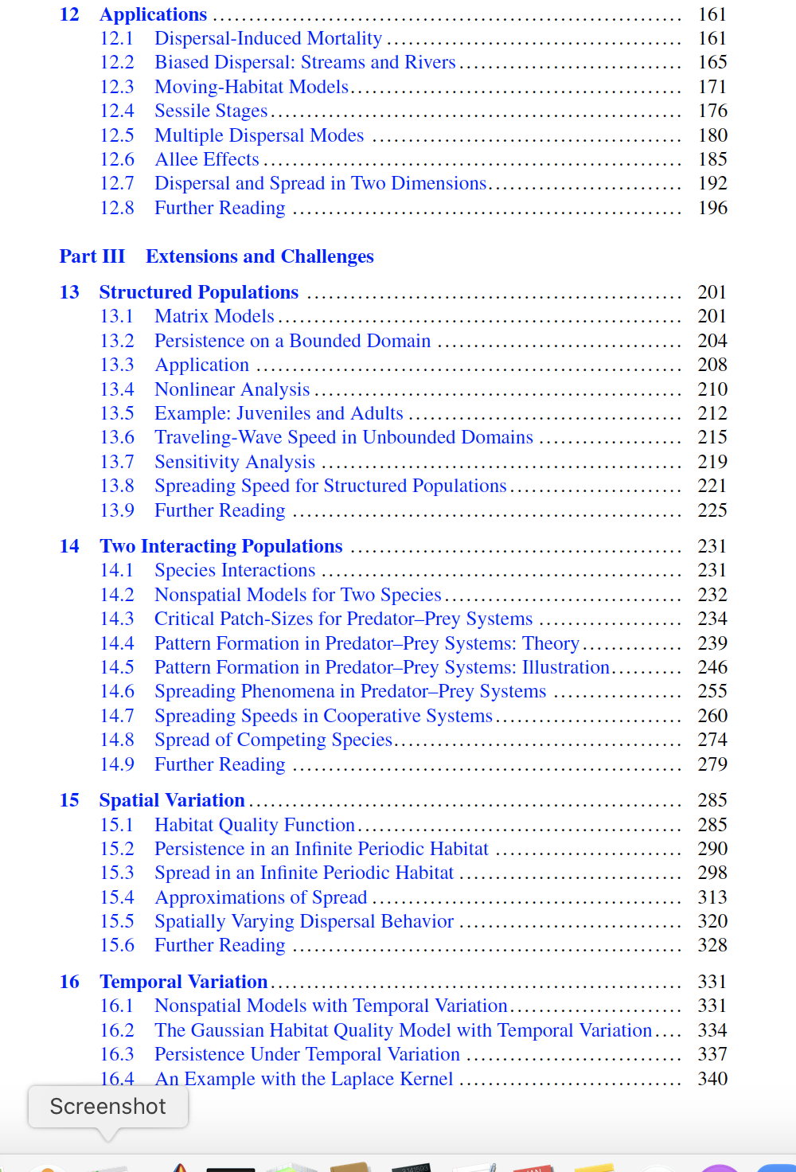
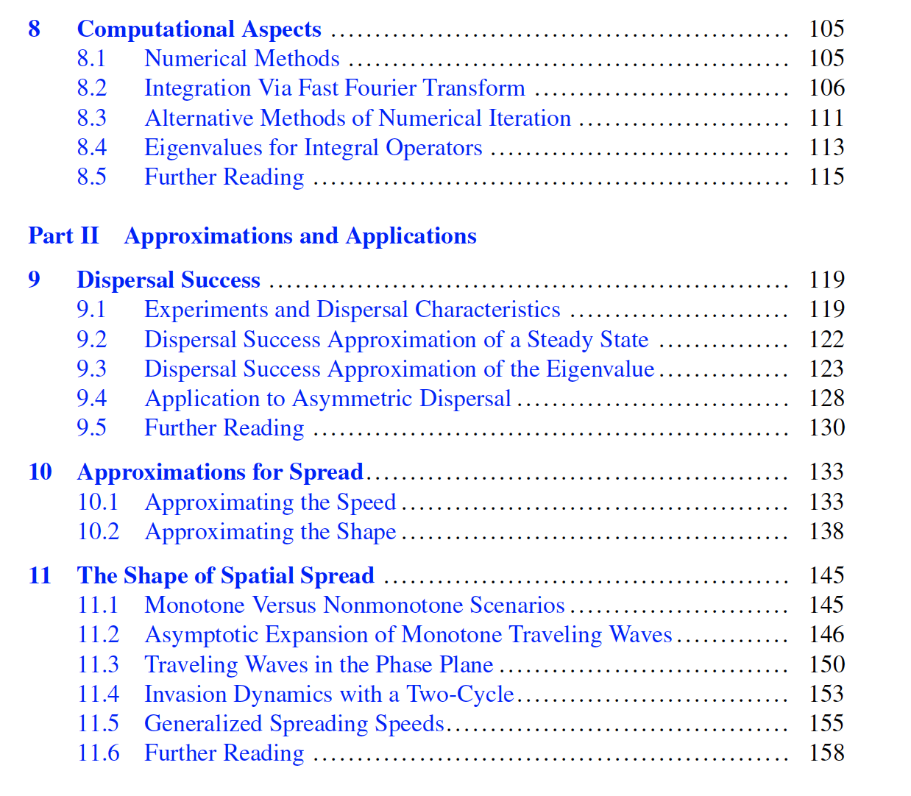
Topics in the text

Slide 10
Topics Frithjof recommends
The below he suggests are “musts”:
Chapter 2 – Basics of growth and dispersal functions and a simple case study
Chapter 3 – Critical patch sizes and effects of dispersal kernels
Chapter 5 – Speed of spread and wave fronts
After this he says
Chapters 4 (positive steady states) and 6 (Allee effects) have a fair amount of proofs and may be of interest to those who want to delve into these
Chapter 7 on connections to random walks and bounded domains can readily be a useful presentation
Chapter 8 on computational methods would be of interest for the numerical aspects
There are lots in Parts II and III that could be presentations for those interested in the topics
He has a website with lectures, Matlab codes and notes at
integrodifference.frithjof.ca

