Slide 1

Gender, Faculty Salaries and Inequity at UTK
Louis J. Gross
Distinguished Professor of Ecology and Evolutionary Biology and Mathematics
Director, The Institute for Environmental Modeling
Founding Director, National Institute for Mathematical and Biological Synthesis (NIMBioS)

Slide 2
Background:
For many years in the 1990’s and early 2000’s, Institutional Research produced a report on faculty salaries that considered data on gender. These were calculated at College level and indicated large differences between male and female salaries across campus that the administration attributed to differential representation by gender in units with very different market-driven salaries. Given the limited way the data were presented, it was not possible to test this assertion.

Slide 3
Background:
Over the same period, the Faculty Senate Budget and Planning Committee (of which I was a member and Chair for several years) produced reports on faculty salaries by departments, broken down by rank, to allow comparisons to peer institutions. These reports did not include data on gender, as these data were not provided to the Committee.
There were consistent requests to the administration from the Commission for Women and the Women’s Studies Program for a more complete analysis of gender and faculty salary.

Slide 4
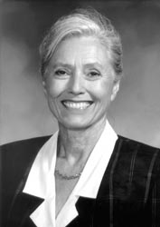

Professor Emeritus Cheryl Travis,
Psychology and long-time Chair of
Women’s Studies
Dr. Bruce Johnson,
Naval Surface Warfare
Center
After many conversations with Cheryl over the years, when I became President of the Faculty Senate in 2006 I formally requested the data on gender and salary from then Chancellor Crabtree and Provost Holub and hired a Grad Assistant for the Senate to assist with the study.

Slide 5
2007 Analysis
After obtaining anonymized (by faculty member and unit) data in early 2007, we developed a report with objectives to:
1. Evaluate if female faculty salaries across UTK are significantly different from those of males when one takes into account differences in units, longevity and rank.
2. Develop a methodology to quantitatively analyze the impact of any potential equity adjustment plan on salary distributions across campus.
3. Develop a methodology to analyze unit-level impacts on any gender-based salary differences across campus (e.g. provide a method to partition the contribution of different units to the distribution of salary differences between genders).

Slide 6
2007 Analysis
The 2007 analysis used resampling techniques, applied when it is not clear what the underlying statistical distribution for an observed outcome of an experiment should be, and when there are limited data so that statistical approaches which rely on large sample-sizes cannot be used. This uses a given set of a data again and again, re-assorting them in a random manner to calculate an underlying statistic many, many times, thus constructing the distribution for the underlying statistic ("bootstrapping" the sample) and the observed value of this statistic can then be compared to the distribution.
We essentially created many, many virtual UTKs with identical salary data, but with salaries assigned randomly, independent of gender, within units, rank and longevity status.

Slide 7
2007 Analysis
For the virtual UTKs in each bootstrap sample, the difference in average salary (male minus female) in each unit and rank, is averaged across the entire campus, weighting each unit/rank value according to the number of faculty gender-pairs in each average. This weighting provides a scaling to ensure that units/ranks with the most balanced gender ratios are counted more heavily than those with the least balanced gender ratios. This provides a single statistic for weighted mean salary difference for each "virtual UTK" created.
This statistic is for the distribution of average faculty salary differences (male – female) across campus, under the null hypothesis that salaries are equally likely to be assigned to males or females within each rank and unit.

Slide 8
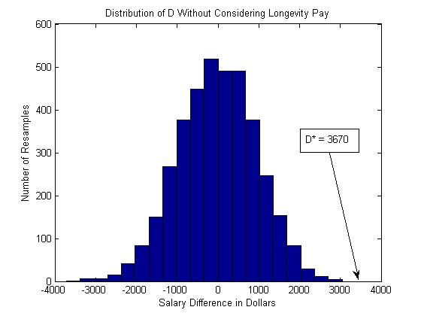
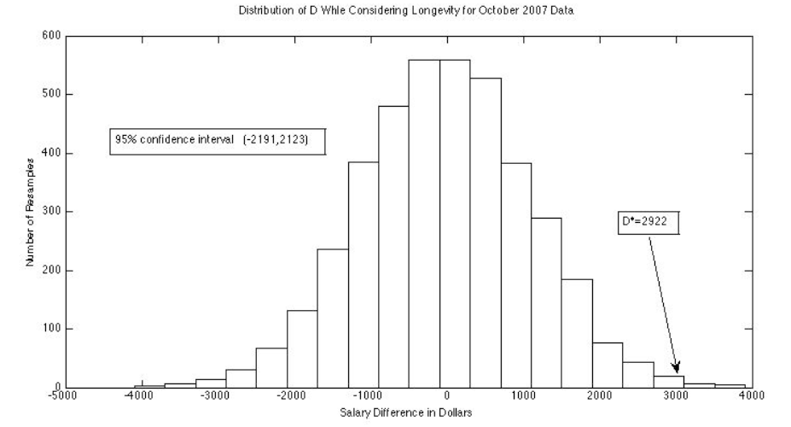
2007 Analysis Results
Male minus female salary statistic across all UTK units, for resampling data of Fall 2007 (4000 samples), and the single actual value. So there was a $3640 difference in salary that was not accounted for by differential representation by gender in units with different market values.

Slide 9
2007 Analysis Results
The report also calculated how much of the $3640 difference across campus arose due to different units. This provides a basis for determining whether some corrective action is appropriate, potentially prioritizing this across the large number of departmental units on campus. The results could focus administrative attention on particular units from which perhaps a reassessment of salaries could have a large impact to reduce the observed salary differences.

Slide 10
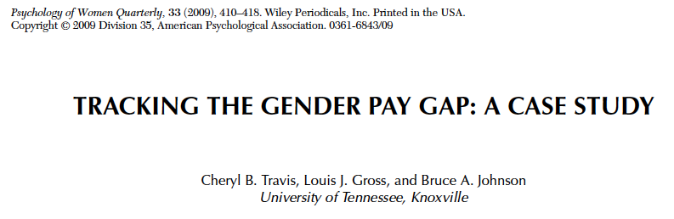
This peer-reviewed paper summarized the resampling analysis as well as more traditional regression methods using the 2007 salary data.
For the full history of reports including the latest ones, see the UTK Faculty Senate Budget and Planning Committee Website

Slide 11
Analysis Results for 2007-8
Across-the-board and equity raises were given in Spring 2007 and the analysis was repeated after these raises – there was no impact on the salary differences.
In Fall 2007, an across-the-board raise pool was 3% and a merit pool was 2%. The merit pool was split so that 25% of it was focused on females only, with the remaining 75% going to both males and females. There was no change in the gender-based differences in salary despite the decision to focus part of the merit pool on redressing gender differences.

Slide 12
Analysis Results for 2007-8
 | Spring 2007 Mean Salary Males | Fall 2007 Mean Salary Males Predicted | Fall 2007 Mean Salary Males Actual | Spring 2007 Mean Salary Females | Fall 2007 Mean Salary Females Predicted | Fall 2007 Mean Salary Females Actual
Assistant Professor | 61,976 | 64,765 | 65,823 | 55,797 | 58,928 | 58,963
Associate Professor | 74,630 | 77,988 | 77,571 | 67,698 | 71,609 | 71,545
Professor | 98,219 | 102,640 | 104,522 | 85,873 | 92,167 | 90,388
The expected and actual changes in mean salary for male and female faculty based upon an across-the-board raise pool of 3% and a merit pool of .5% for females and 1.5% allocated independent of gender from Spring 2007 to Fall 2007 (values in $).

Slide 13
Analysis Results for 2015
No similar analysis was performed until the data for Fall 2015 salaries were supplied to the Committee in April 2016 and these included Instructors and Lecturers.
There are considerable differences by gender in mean and median salaries at all Professorial ranks, with males having consistently higher mean and median salaries. On average, female Professorial faculty receive 80% of the salary of male Professorial faculty. These differences are not present at Instructor and Lecturer ranks. The resampling statistic shows that there has been considerable improvement though there is still an approximate $2500 difference between male and female salaries that is not explained by differential representation by gender in units with different market salaries.

Slide 14
Analysis Results for 2015
As in earlier analyses, a limited number of units contribute the greatest amount to the observed differences between male and female salaries.

Slide 15
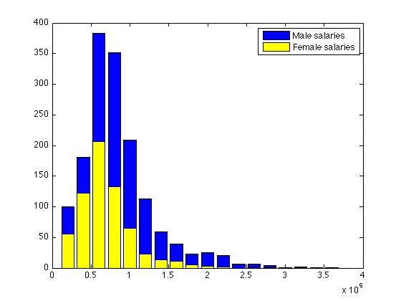
Analysis Results for 2015
Histogram of all Fall 2015 Faculty Salaries with the horizontal axis giving salaries in $ and the vertical axis giving the numbers of males (upper bars – in blue) and females (lower bars –in yellow) at each salary level .

Slide 16
Analysis Results for 2015
For the top 5% of Professorial salaries (not including Instructors and Lecturers) out of 1204 total individuals this is 60 individuals of which 7 are females. So 11.7% of the individuals in the highest 5% of faculty salaries are females and 88.3% are males. For the top 10% of salaries, this is 120 individuals, of which 20 are female so 16.7% of the individuals in the highest 10% of salaries are female faculty and 83.3% are male faculty.
Overall, 34.7% of the Professorial faculty are female.

Slide 17
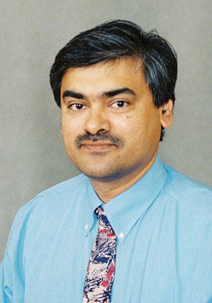
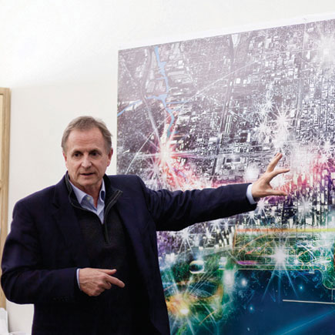


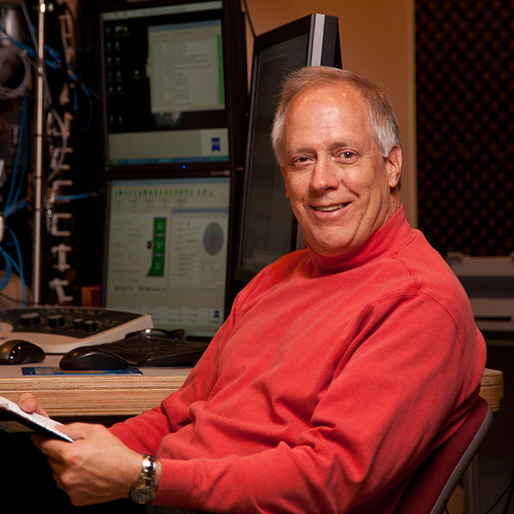
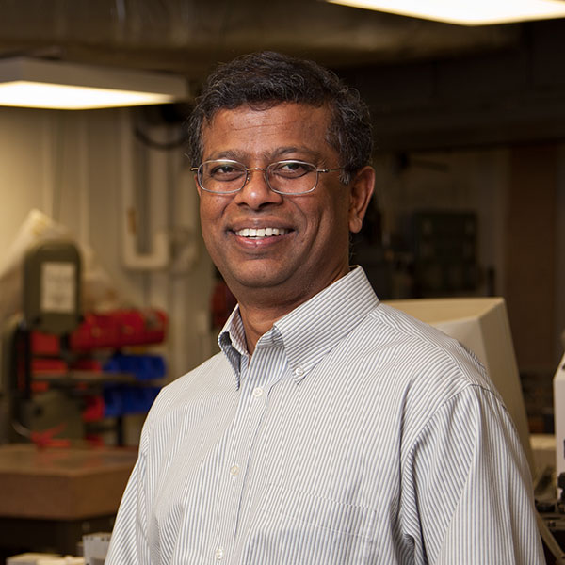
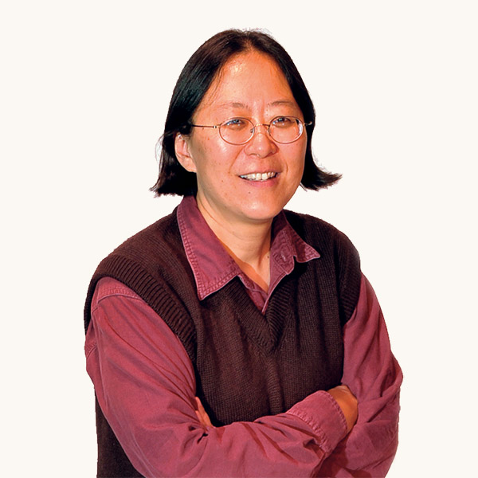

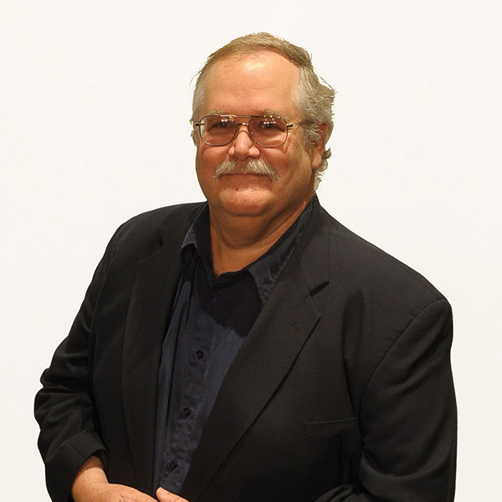
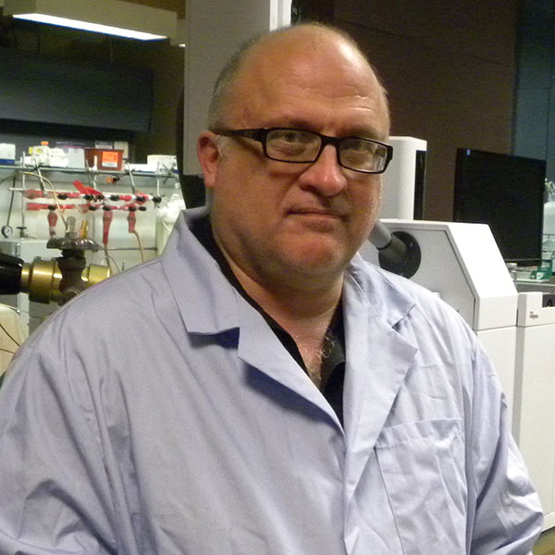




Governor’s Chairs:
14 total, 1 female

Slide 18

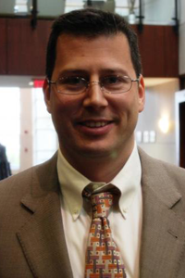
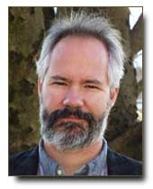
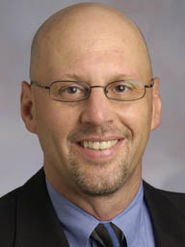

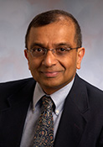
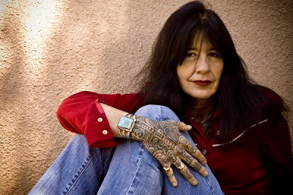
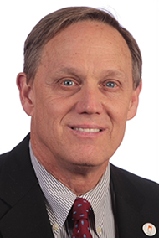
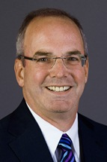
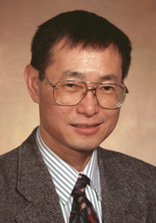
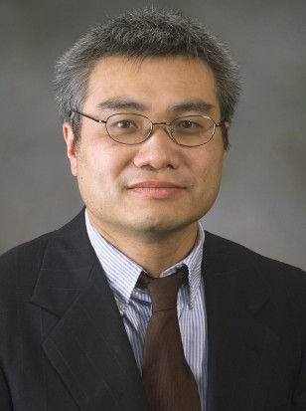
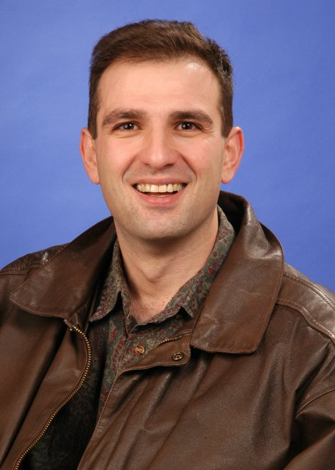
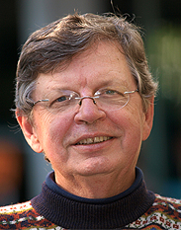

Chairs of Excellence:
14 total, 1 female

Slide 19
Other Results for 2015
1. Since 2007, the Professorial faculty numbers have increased slightly (from 1184 to 1204) while the number of Instructors and Lecturers increased from 250 to 323.
2. Since 2007, the gender balance of the Professorial faculty has remained constant with 35% of the faculty being female, while the fraction of the total faculty who are female increased from 38% to 42% due to an increase in female Instructors and Lecturers.
3. The ratio of female-to-male salary was .763 in 2015 including Instructors and Lecturers and the ratio for Professorial Faculty (all ranks) was .802 and these ratios are essentially the same as they were in 2007.

Slide 20
Other Results for 2015
4. Since 2007, at all ranks and for all genders there have been significant increases in mean and median salaries. There has been no consistent difference in percent salary increases by gender over this time period.
5. There is some evidence that there are gender differences in salary not accounted for differential representation of faculty by gender in units with different faculty market values, but the evidence is much weaker than that from 8-years ago and cannot be said to be statistically significant.
6. A small set of units contribute the greatest to the gender salary differences across campus.

